Slide 1
Basic Feature Engineering
Machine Learning through Application
Module 2 – Lesson 2

Slide 2
Today’s activities
Feature engineering
Processing categorical features
Text preprocessing
Text vectorization

Slide 3
Feature engineering

Slide 4
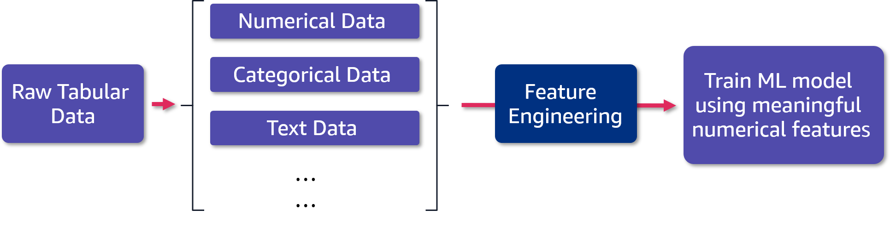
Feature engineering: Definition
Feature engineering is using domain and data knowledge to create novel numerical features from raw data.
Notes:
~Alt text: Data preparation and training flow.
~
Consider a raw dataset that consists of multiple types of features, including numerical, categorical, and textual data. All these need to be processed into numerical type features for the algorithm to be able to interpret them. These features are then used to train ML models.

Slide 5
Feature engineering: Using intuition
What information would a human expert use to make a prediction?
The process is often more of an art than a science.
Feature construction (multiplication, squaring)
Feature extraction (encoding, vectorization)
Feature selection (dimensionality reduction)
Notes:
~Alt text: Data preparation and training flow.
~
Consider whether you need all the data that you have collected. This is where domain expertise becomes important. More data is not necessarily better, but relevant meaningful data is.
To decide how the features will be used, some intuition is often useful. For example, ask yourself what information a human would use to make a prediction.
Domain knowledge and feature engineering experience with similar problems or data also help. You can also use exploratory data analysis (EDA) observations to reduce or select features, such as removing some correlated variables.

Slide 6
Processing categorical features

Slide 7

How can you process categorical features?
Categorical (also called discrete) features don’t have a natural numerical representation.
Example: color $∈$ {green, red, blue}, size $∈$ {Large, Medium, Small}
Most ML models require converting categorical features to numerical ones.
Notes:
~Equation text
~
It is important to remember that you need numerical features to train and use ML models. Categorical features are not numerical.

Slide 8
How to convert categorical features
Common techniques
Number assignment: Assign a number to each category value.
One-hot encoding: Create new binary (0 or 1) columns.
Target encoding: Calculate values for categorical features by using the target statistics for them.

Slide 9
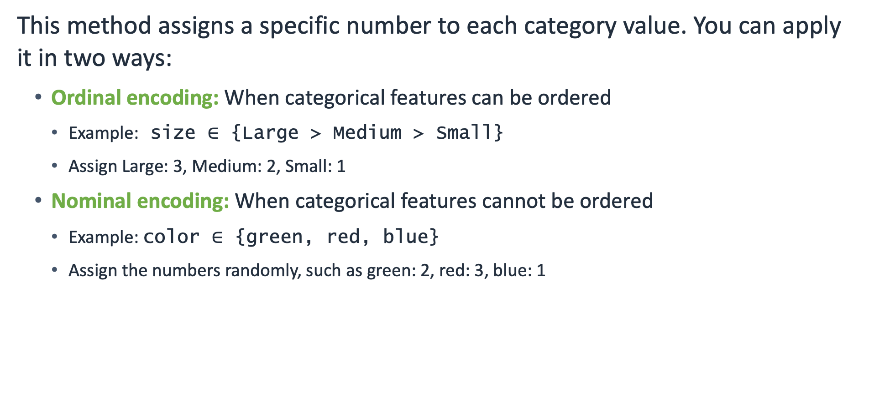
Number assignment technique
This method assigns a specific number to each category value. You can apply it in two ways:
Ordinal encoding: When categorical features can be ordered
Example: size $∈$ {Large > Medium > Small}
Assign Large: 3, Medium: 2, Small: 1
Nominal encoding: When categorical features cannot be ordered
Example: color $∈$ {green, red, blue}
Assign the numbers randomly, such as green: 2, red: 3, blue: 1
Notes:
~Equation text
~
One easy way to get numerical features is to replace categorical values with numbers. You can apply this method differently based on whether the categorical features can be ordered.

Slide 10
OrdinalEncoder: An sklearn encoder
It encodes categorical features as numbers.
It uses the regular form:
# Examples of regular form
.fit()
.transform()
By default, the encoder assigns the numbers randomly. If an array is provided, it maps using that.
Assume “color” and “size” are categorical features in a dataset:
# Example encoder for color and size
from sklearn.preprocessing import OrdinalEncoder
ord_encoder = OrdinalEncoder()
df[["color", "size"]] = ord_encoder.fit_transform(df[["color", "size"]])
Notes:
~Code blocks
~
OrdinalEncoder is an encoder from the sklearn.preprocessing module. The encoder encodes categorical features as an integer array.

Slide 11
OrdinalEncoder example
For the following table, encode the categorical features color and size.
After running the code from the previous slide, you can assign size numbers randomly:
Example dataset
Resulting dataset
color | size | price
green | small | 10.1
red | medium | 13.5
blue | large | 15.3
color | size | price
1 | 1 | 10.1
0 | 2 | 13.5
2 | 0 | 15.3
Notes:
For this example dataset, color (green, red, blue) and size (small, medium, large) values are mapped to integers.
Note that even though the size column connotes magnitude, OrdinalEncoder assigns the numbers to these classes randomly, without considering this property.

Slide 12
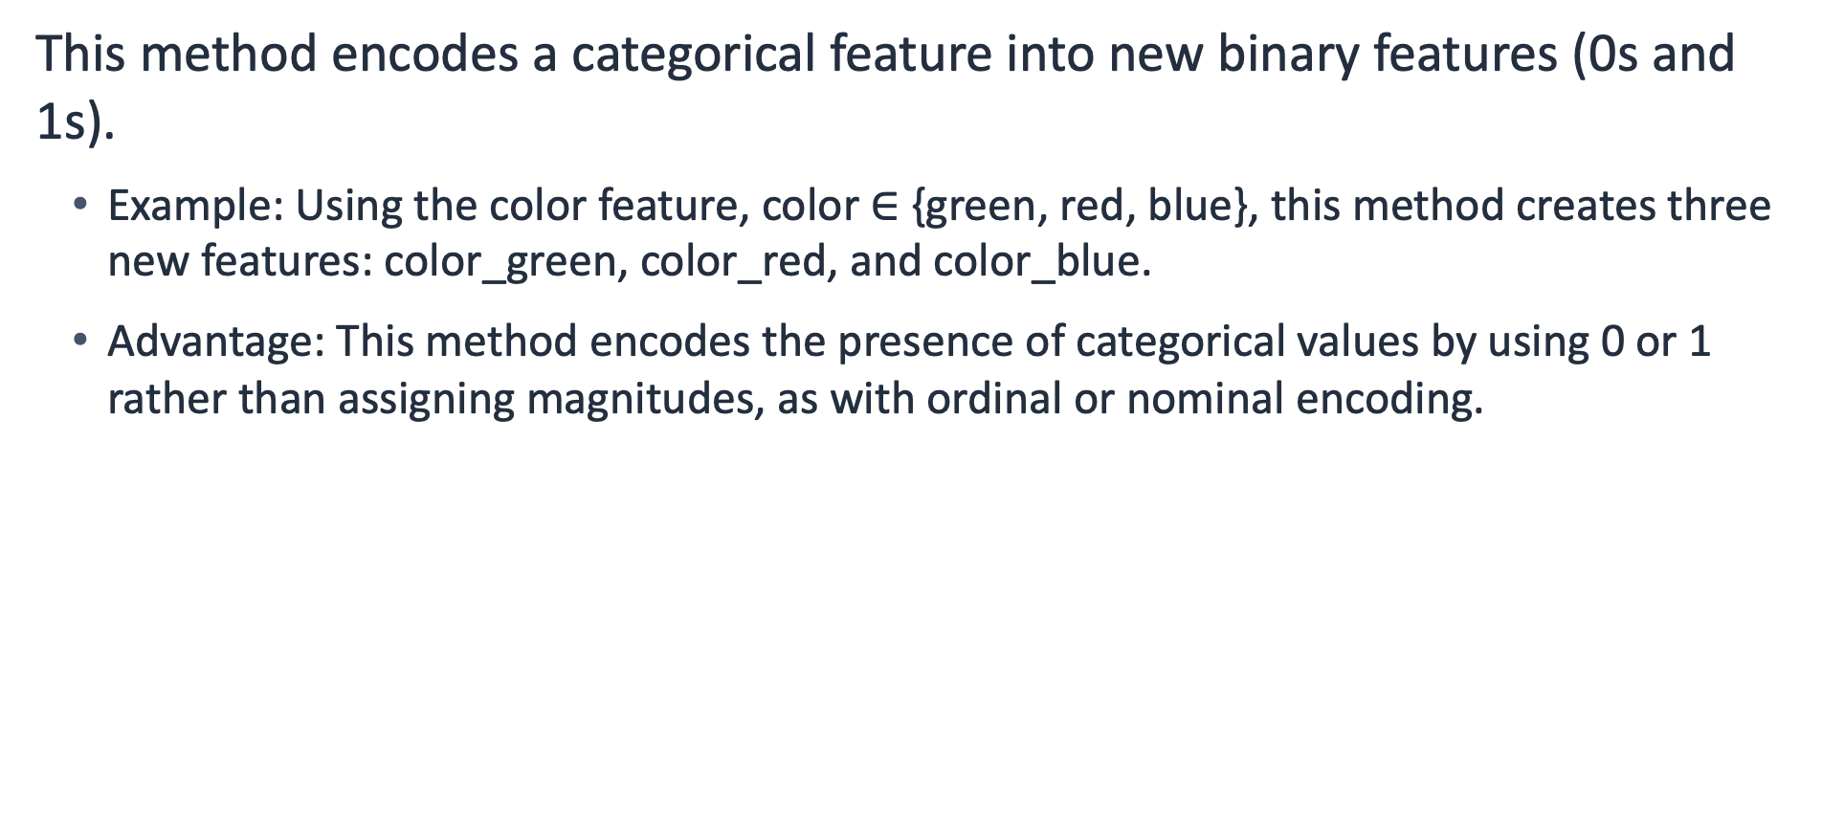
One-hot encoding technique
This method encodes a categorical feature into new binary features (0s and 1s).
Example: Using the color feature, color $∈$ {green, red, blue}, this method creates three new features: color_green, color_red, and color_blue.
Advantage: This method encodes the presence of categorical values by using 0 or 1 rather than assigning magnitudes, as with ordinal or nominal encoding.
Notes:
~Equation text
~
One-hot encoding replaces the original categorical feature with new binary features. One-hot means having a single 1 in a series of numbers that can be 1 or 0. In this coding technique, you use multiple 0s and a single 1 to represent a categorical value. Overall, the number of new binary features that come from this coding technique is equal to the number of unique values in the categorical feature.
For example, the color feature has three unique values: green, red and blue. This results in three new binary features: color_green, color_red, and color_blue. The next slide shows the technique in greater detail for this example.
Although using one-hot encoding is sometimes advantageous when assigning magnitudes, it’s not the best approach (for example, colors). Proceed carefully. This method creates new features, so if there are too many unique categorical values, you might end up with too many features. Later slides in this lesson will explain some improvement strategies.

Slide 13
OneHotEncoder: An sklearn encoder
This method encodes categorical features as a one-hot numeric array.
It uses the regular form:
# Examples of regular form
.fit()
.transform()
Example: Encode the color feature in the example dataset.
Example dataset
Resulting dataset
color | size | price
green | small | 10.1
red | medium | 13.5
blue | large | 15.3
size | price | color_blue | color_red | color_green
2 | 10.1 | 0 | 0 | 1
1 | 13.5 | 0 | 1 | 0
0 | 15.3 | 1 | 0 | 0
Notes:
~Code block
~
Sklearn’s OneHotEncoder is an easy-to-use tool for one-hot-encoding. It has the regular fit() and transform() features.
In the example, the color feature is converted into the color_blue, color_red, and color_green features. Zeroes are used in all locations except one in every assignment. for example, green becomes 0, 0, and 1 for the color_blue, color_red, and color_green features, respectively.

Slide 14
OneHotEncoder sample code
Sample code is shown here. This code produces the new features shaped as 3x3.
# sklearn OneHotEncoder sample code
from sklearn.preprocessing import OneHotEncoder
one_hot_encoder = OneHotEncoder()
new_colors = one_hot_encoder.fit_transform(df["color"].values.reshape(-1, 1))
Notes:
~Code block
~
This slide displays sample code for the OneHotEncoder in sklearn. df[color’] is processed to produce a 3x3 feature matrix: [[0, 0, 1],
[0, 1, 0],
[1, 0, 0]]

Slide 15

Target encoding
This method replaces categorical features with their target statistics.
Example: Averaging the target value (“isSold”) for each color category.
Example dataset
Target statistics
color | size | price | isSold
green | small | 10.1 | 1
red | medium | 13.5 | 0
blue | large | 15.3 | 1
red | small | 11.2 | 1
green | large | 9.2 | 0
$$\text{green} \text{=}\text{ (1 + 0)/2 = 0.5} \\ \text{red} \text{=} \text{(0} \text{+} \text{1)/2 = 0.5} \\ \text{blue} \text{=} \text{1/1 = 1} \\ \text{small} \text{=} \text{(1} \text{+} \text{1)/2 = 1} \\ \text{medium} \text{=} \text{0/1 = 0} \\ \text{large} \text{=} \text{(1} \text{+} \text{0)/2 = 0.5 }$$
Notes:
Unlike the other encodings, target (or mean) encoding uses the target variable to generate encodings for its categorical features. Calculated target statistics (which are numerical values) replace the categorical values.
In this example, target statistics are calculated as follows: Two data points have “green” for color, and the isSold values are 0 and 1. The mean value is (1 + 0)/2 = 0.5. Therefore, 0.5 is used instead of the green value.
You can follow the same logic for the other categorical features and get the target statistics as shown on the slide.

Slide 16

Target encoding: Converted dataset
Converted dataset
Target statistics
color | size | price | isSold
0.5 | 1.0 | 10.1 | 1
0.5 | 0.0 | 13.5 | 0
1.0 | 0.5 | 15.3 | 1
0.5 | 1.0 | 11.2 | 1
0.5 | 0.5 | 9.2 | 0
$$\text{gr}\text{een}⟶\text{0.5} \\ \text{red}⟶\text{0.5} \\ \text{blue}⟶\text{1} \\ \text{small}⟶\text{1} \\ \text{medium}⟶\text{0} \\ \text{large} ⟶\text{0.5 }$$
Notes:
In the converted dataset table on this slide, the color and size categorical values were replaced with the target statistics that were calculated.

Slide 17
Improving the feature representations: Hierarchy
You can improve categorical feature representations by reducing the number of unique values.
One method is to use your domain knowledge to build a hierarchy structure.
Example: ZIP codes
The US has approximately 42,000 unique ZIP codes.
Could use regions -> states -> city as the hierarchy and choose a specific level to encode the ZIP code feature.
98109 becomes “Pacific northwest”-> “WA”-> “Seattle”.
Notes:
The number of categories per categorical feature can easily increase. It is usually a good practice to reduce the number of unique values.
ZIP code is a great example. A ZIP code feature will have too many unique values. You can define a hierarchical structure to deal with that.

Slide 18
Improving the feature representations: Group or bin
Another method is to group or bin the categories into fewer groups by similarity.
Example: User demographics data
Create age groups: 1–15, 16–22, 23–30, and so forth.
You can determine the range of values in the groups or bins and the sizes of the groups or bins.
Notes:
Another way to reduce the unique values is to group or bin them. You can merge similar ones and create some groups or bins.

Slide 19
Text preprocessing

Slide 20
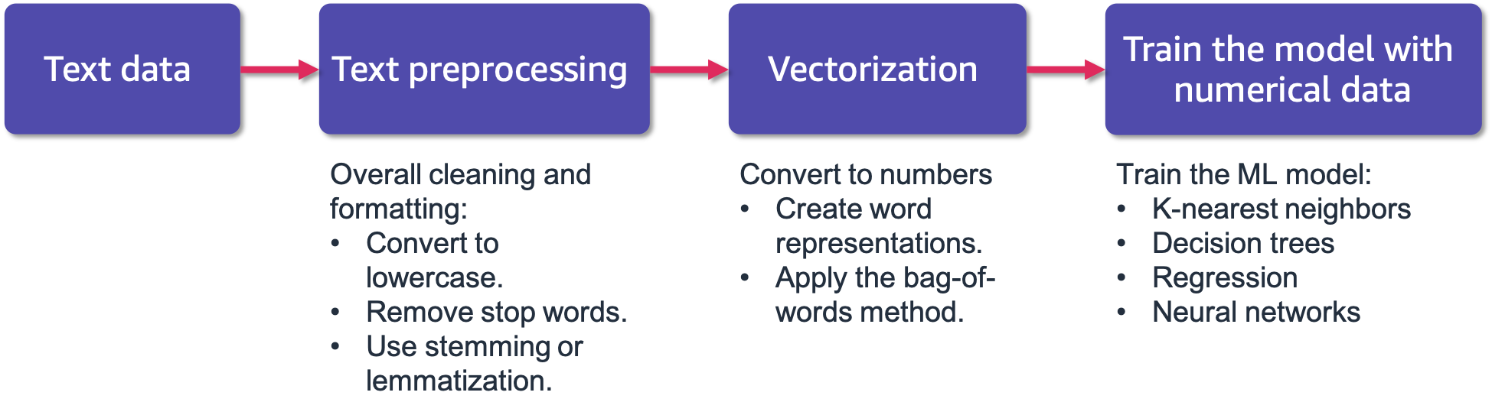
ML with text data
Text is a common data type and can appear in titles, names, reviews, or any freeform input.
ML models need well-defined numerical features.
Notes:
This slide shows a flowchart of operations to convert text data into numerical type data. The main processes are text preprocessing and vectorization.
Text preprocessing helps to clean and format the text data accordingly.
Vectorization handles the conversion from text type to numerical type. This is a general topic that can involve different methods, such as word vectors or sentence embeddings. This lesson will focus on the bag-of-words method.

Slide 21
Cleaning text data
Motivation: It is more difficult to find patterns in unorganized text.
Clean the text by removing noise from it.
Common techniques include the following:
Convert all characters to lowercase.
Remove unnecessary characters, such as white space, special characters, punctuation, and HTML markup.
Remove stop words: Stop words are common words that contribute little to the overall meaning of the text.
Use the root forms of the words (by stemming).
Notes:
With the goal of helping an ML model to find patterns in text data, cleaning text data can involve the following techniques:
Converting all characters to lowercase
Removing white space, special characters, punctuation, and HTML markups
Removing stop words
Stemming
Keep in mind that different problems might need different processes.

Slide 22
Tokenization
This process splits text into small parts by white space and punctuation.
Example:
Sentence: I don’t like to eat eggs.
Tokens: I, do, n’t, like, to, eat, eggs, .
Tokens are used in the next steps of text preprocessing.
Notes:
The original text can be split into sentences to be analyzed later, and the sentences can be further split into words, called tokens.

Slide 23
Removing stop words
Remove words that frequently appear in texts but contribute little to the overall meaning.
Stop words include the following: a, the, so, is, it, at, in, this, there, that, my, by, nor.
Example:
With stop words: There is a tree near the house.
Without stop words: tree near house.
Notes:
Another preprocessing step is removing stop words. This involves removing the extra words that contribute little to the meaning of the text. Usually, stop word lists are created or curated specifically for the problem. This could include ”a”, “the”, “so”, “is”, “it”, “at”, “in”, “this”, “there”, “that”, “my”, “by”, “nor”, among others.

Slide 24
Stemming
Stemming is a set of rules to reduce a string (word) to a substring (stem or root form) that usually refers to a more general meaning.
The goal is to remove word affixes (particularly suffixes), such as -s, -es, -ing, and -ed.
Example:
playing
played
plays
play
Notes:
~Alt text – brace: Playing, played, and plays are stemmed to become play.
~
To further reduce the vocabulary size and focus on the general meaning of the words, you can reduce words to their roots by removing affixes, particularly suffixes. This is a rule-based simple approach.
However, stemming rarely works with irregular forms, such as “taught” and “brought.” For those, you can use a more advanced version called a lemmatizer. For more information, see Lemmatisation at https://en.wikipedia.org/wiki/Lemmatisation.

Slide 25
Apply these methods
Process the following sentence:
“The countess (Rebecca) considers\n the boy to be quite naïve.”
Processed sentence: countess rebecca consider boy naive
Steps taken:
Converted text to lowercase
Removed white space, special characters, and punctuation
Removed stop words
Stemmed words
Notes:
Consider the example on the slide. To preprocess this example text, the text is converted to lowercase; white space, special characters, punctuation, and stop words are removed; and words are stemmed.

Slide 26
Text vectorization

Slide 27
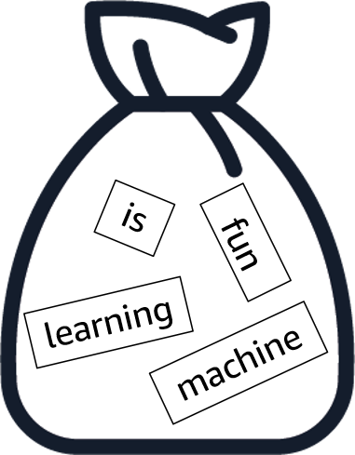
Text vectorization: Bag-of-words method
Reminder: ML models need well-defined numerical data.
The bag-of-words method represents a text as a set of its words (a bag), disregarding the grammar and order of the words.
Think of it as taking words from a sentence and putting them in a bag.
“Machine learning is fun”
Notes:
~Alt text: Bag with the words machine, learning, is, and fun inside. The words aren’t in the same order as the original sentence.
~
The bag-of-words method represents a text as a set of its words. Think of taking the words from a sentence and putting them together in a bag.
While this is a simple method, the representation doesn’t include the order of the words. In the example on the slide, after you get the bag-of-words representation for “Machine learning is fun,” you no longer know the word order.

Slide 28

Text vectorization: Bag-of-words method steps
Steps:
Construct or get a main vocabulary.
For each text (bag), calculate occurrences of the words from the main vocabulary.
Binary (1 if in the text, 0 otherwise)
Counts (count how many times seen in the text)
Notes:
The first step is to construct or get a main vocabulary. You can construct a vocabulary by using the words that you have in your dataset.
Then, for each text, calculate the occurrences of the words in the text. This can be binary (1 or 0) or counts (how many times seen in the text).

Slide 29
Text vectorization: Example
Assume that you have three customer reviews to work with.
The text features are title and textBody. Select one feature at a time.
Example dataset
userID | title | textBody
xCsIoq3 | Good value | This product works great!
iUnd12y | Didn’t work | It did not work.
p3Yyt35q | My kids loved it! | Perfect Christmas gift for kids.
Notes:
Consider having a dataset or table of text. You might have multiple text columns, such as title, main text, and comment. You can create vectors for each text field by using the bag-of-words method.
Consider a table that has userID, title, and textBody fields. The text features are title and textBody. Select one feature at a time.

Slide 30
Text vectorization: textBody field
Use binary representation (0 or 1) with the textBody feature.
Vocabulary from the three sentences
textBody | christmas | did | gift | great | for | it | kids | not | perfect | product | this | work(s)
This product works great! | 0 | 0 | 0 | 1 | 0 | 0 | 0 | 0 | 0 | 1 | 1 | 1
It did not work. | 0 | 1 | 0 | 0 | 0 | 1 | 0 | 1 | 0 | 0 | 0 | 1
Perfect Christmas gift for kids. | 1 | 0 | 1 | 0 | 1 | 0 | 1 | 0 | 1 | 0 | 0 | 0
Notes:
Start with the textBody feature, and use binary representation (0 or 1) for the feature.
First, you create a vocabulary. Use the words in the three sentences from the textBody field. The words become the columns of a new table. Then, calculate the occurrences. For each sentence, if the vocabulary word appears in the sentence, enter 1 in the table. If it doesn’t appear, enter 0.

Slide 31
Text vectorization: Vector representations
Use binary representation (0 or 1) with the textBody feature.
textBody (original text form) | Bag-of-words vectors (numerical representation)
This product works great! | [0, 0, 0, 1, 0, 0, 0, 0, 0, 1, 1, 1]
It did not work. | [0, 1, 0, 0, 0, 1, 0, 1, 0, 0, 0, 1]
Perfect Christmas gift for kids. | [1, 0, 1, 0, 1, 0, 1, 0, 1, 0, 0, 0]
Note: You can apply the same method to the title field in the table and construct vectors for that feature.
Notes:
Now you have the vectors. You can use these vectors as features to train a classifier.
You can apply the same procedure to the title field and get their vectors. At the end, you can combine these vectors for each row in the table and treat them as the features.

Slide 32
Bag-of-words method in sklearn
CountVectorizer in sklearn implements the bag-of-words method.
It is a text vectorizer that converts a collection of text documents to a matrix of token counts.
It uses the regular form:
# Examples of regular form
.fit()
.transform()
# Example sklearn code
from sklearn.feature_extraction.text import CountVectorizer
countVectorizer = CountVectorizer(binary=True)
Sentences = [
"This is the first document.",
"This is the second document.",
"and the third one.",
]
X = countVectorizer.fit_transform(sentences)
Notes:
~Code blocks
~
Sklearn implements this method. It uses the regular fit() and transform() functions.

Slide 33

Next lesson
How to train an ML model by using these features.
You will learn about decision trees.

