Slide 1
Optimization, Regression Models, and Regularization
Machine Learning through Application
Module 2 – Lesson 4

Slide 2
Today’s activities
Optimization
Regression models
Regularization

Slide 3
Optimization

Slide 4
Optimization in ML
When you build and train an ML model, you hope for the following:
However, the reality is usually as follows:
Difference = error
Goal: Train more until the error gets as small as possible!
Notes:
~Alt text – features-rules-target: Flowchart of the ideal result for an ML model where features are used to create rules that output the target value.
~Alt text – features-rules-prediction: Flowchart of the real result for an ML model where features are used to create rules that output a prediction.
~Alt text – arrow: Arrow indicates a difference, or error, between the target and predicted value.
~
Every ML model aims to take in the model features and match the model target. In reality, almost all ML models take in the model features and make model predictions that rarely match the model target exactly. Some error occurs.
The key focus of ML is learning better models where the overall model error gets smaller—ideally, as small as possible!

Slide 5

Minimizing an error function of the ML model
Example error function: $error=f\left(w\right)$
$error$ = How accurate the model is
$f$= the model
$w$= input, such as weights, parameters, or other variables in your model
Involves finding the input $(w)$ that results in the lowest error value (in the training time that is allotted)
Notes:
~Equations
~
Consider an ML model that makes some error. That error depends on the predictions of the model—therefore, the error depends on the ML model and its parameters. Consider w (w as in weights) to represent the collective parameters of the model. Then, the model’s error as a function of w becomes f(w).
The best model is the one that generates the lowest possible error. This means that ML’s main problem becomes an optimization problem.

Slide 6
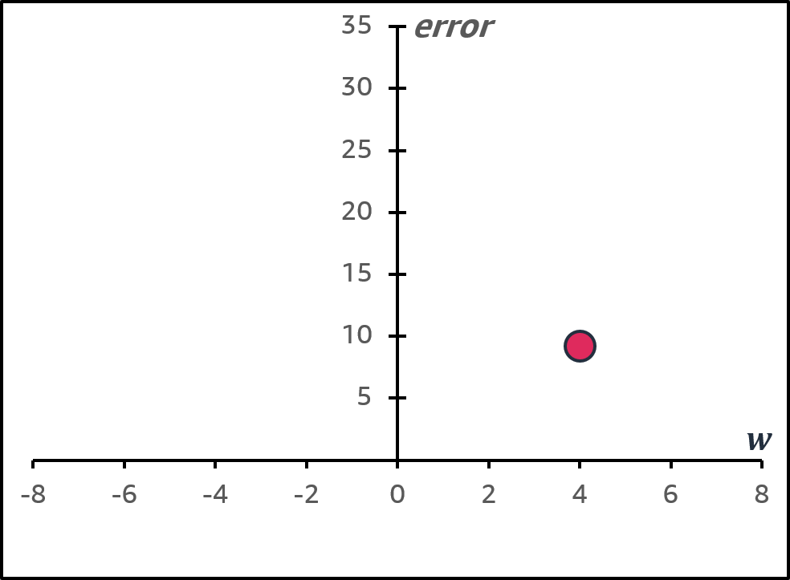

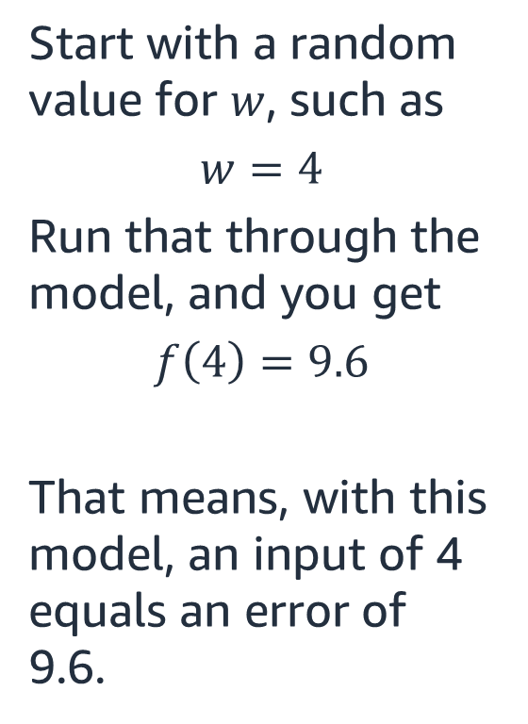
How do you determine how w changes the error?
$$error=f\left(w\right)= ?$$
Start with a random value for $w$, such as
$$w=4$$
Run that through the model, and you get
$$f\left(4\right)=9.6$$
That means, with this model, an input of 4 equals an error of 9.6.
Notes:
~Equation
~Alt text: Graph of the error function with a point at (4, 9.6).
~
If the current ML model is not a good model (generates higher errors), how should you change the model?
The plot shows the error related to this starting value for w on the y-axis—in this example, 9.6. How should you change its value to reduce the error? By moving the w value closer to zero error on the y-axis.

Slide 7
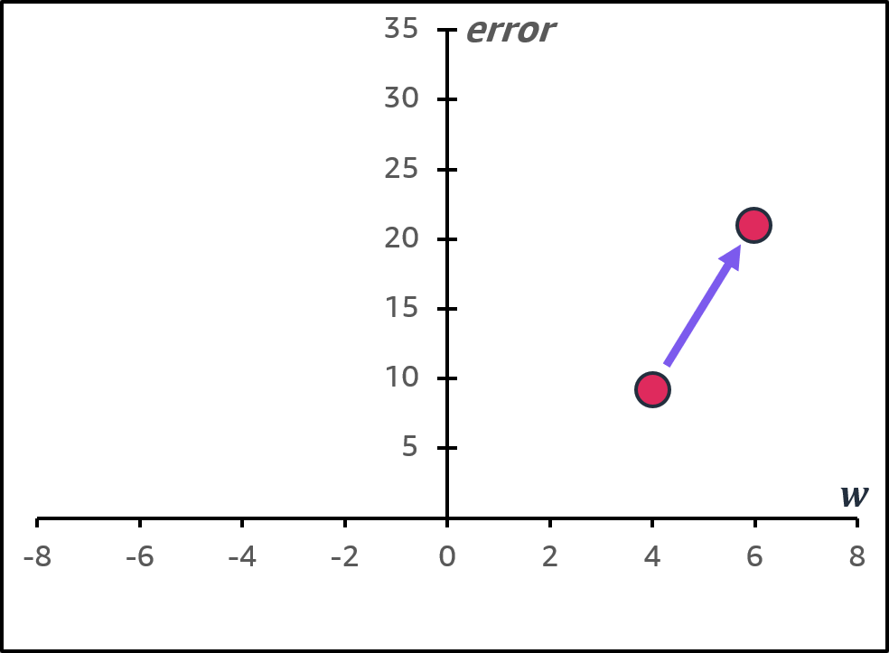
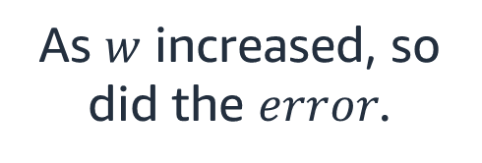

What about w = 6?
$$error=f\left(w\right)= ?$$
$$f\left(6\right)=21.6$$
As $w$ increased, so did the $error$.
Notes:
~Equations
~Alt text: Graph of the error function with points at (4, 9.6) and (6, 21.6). An arrow shows that error increased as w increased.
~
In one dimension, it’s easy to test and visualize how error changes as you change the weights. When you increase w from 4 to 6, you can see that the error increases.

Slide 8
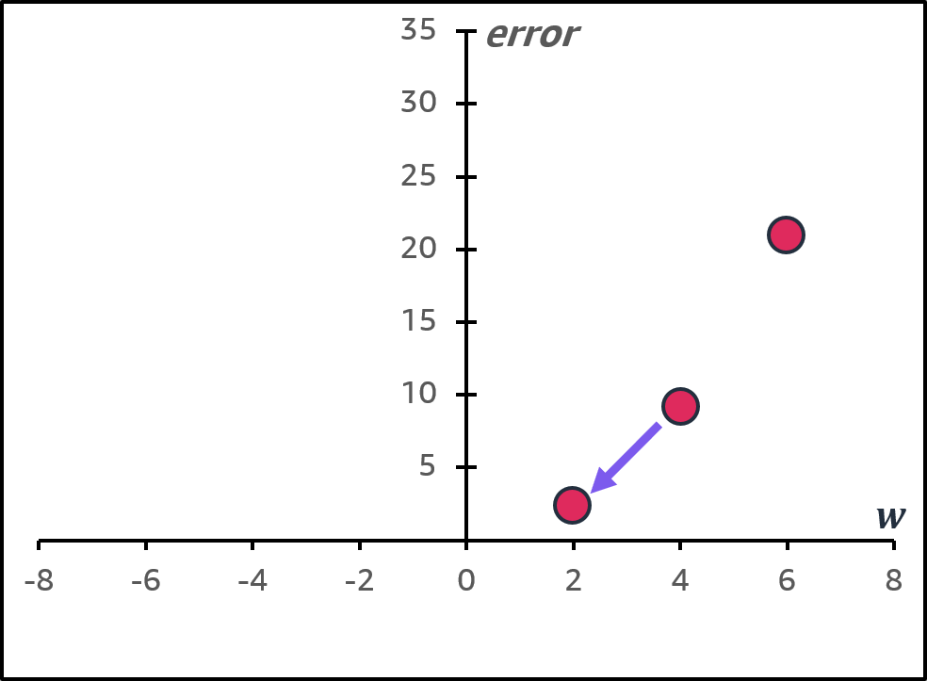
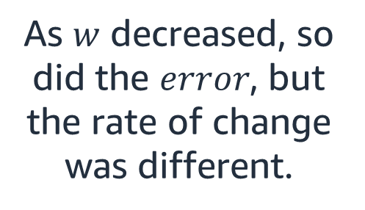

What about w = 2?
$$error=f\left(w\right)= ?$$
$$f\left(2\right)=2.4$$
As $w$ decreased, so did the $error$, but the rate of change was different.
Notes:
~Equations
~Alt text: Graph of the error function. See details in notes.
~
Image description: Graph of the error function with points at (4, 9.6), (6, 21.6), and (2, 2.4). An arrow shows that error decreased as w decreased. End description.
You can do the same check by decreasing w from 4 to 2. In this case, the error decreases.

Slide 9
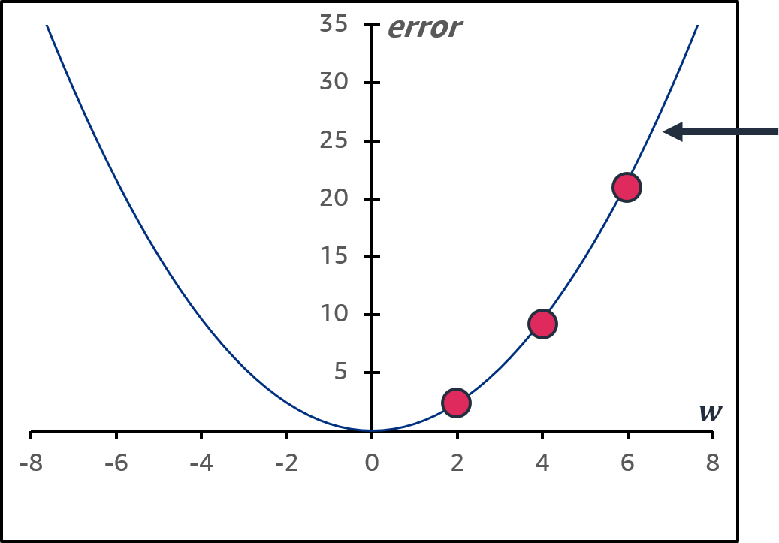
What is happening here?
$$error=f\left(w\right)= ?$$
This is the gradient (rate of change) of this function.
Because this gradient has a direction, it’s called a vector.
Notes:
~Equation
~Alt text: Graph of the gradient function that passes through the points that were calculated on previous slides.
~
As you change the weights, you can see a line that represents the rate of change of the function. This is called the gradient of the function. Using gradients makes it mathematically easier to determine how to minimize the function’s error.
While it might seem easy to visualize and craft a path toward the minimum for a model with this simple function with one feature, the task is more complex as the error function (cost function) adds more features. When you have about three features, you lose the option of visualization altogether.
You can only imagine a similar simpler rule that would help you navigate the dot toward the minimum from whatever (worst, higher) initial position.
Try to imagine moving a little to the left or right related to the x-axis, moving a little up or down related to the y-axis, and moving in or out for additional axes for how many features (dimensions) there are.

Slide 10
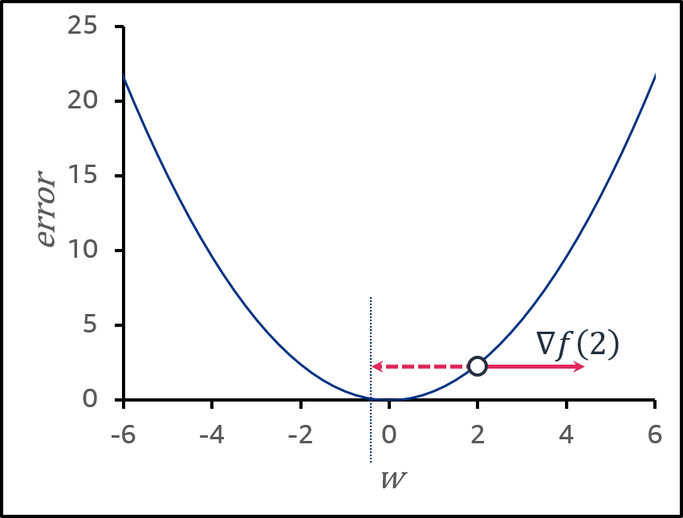


How gradients work mathematically (1 of 4)
$$f\left(w\right)=0.6 w^{2}$$
with gradient vector $∇f\left(w\right)=⟨1.2, w⟩$
The sign of the gradient shows the direction that the function increases: + right and - left
$$∇f\left(2\right)=2.4→\left|∇f\left(2\right)\right|=2.4$$
$$error=f\left(w\right)=0.6w^{2}$$
Notes:
~Equations
~Alt text: Graph of the error function 0.6w^2 with point at (2, 2.4). See details in notes.
~
Image description: Graph of the error function 0.6w^2. A point at (2, 2.4) has +/- gradient vectors to show the direction of the function increase/decrease at that point. End description.
For a one-feature model, and therefore one-weight w, if the error function is a quadratic function, such as 0.6w^2 (think: sum of squared errors), the gradient is computed to be 1.2w. This means that at w = 2, grad = + 2.4. The sign of the gradient shows the direction that the error increases. In this example, the error increases when moving to the right. That means you want to move in the opposite direction (left) to decrease the value of the error function.
Note that if you move the full 2.4 units to the left, you will go beyond the minimum! Although you know you need to go in the opposite direction of the gradient, you might want to take a smaller step—not the full size of the gradient but proportional to the gradient, and control this step size by a parameter. This tactic is also useful for other scenarios, such as when the error function is less curved up, and the step needs to be larger than the size of the gradient.

Slide 11
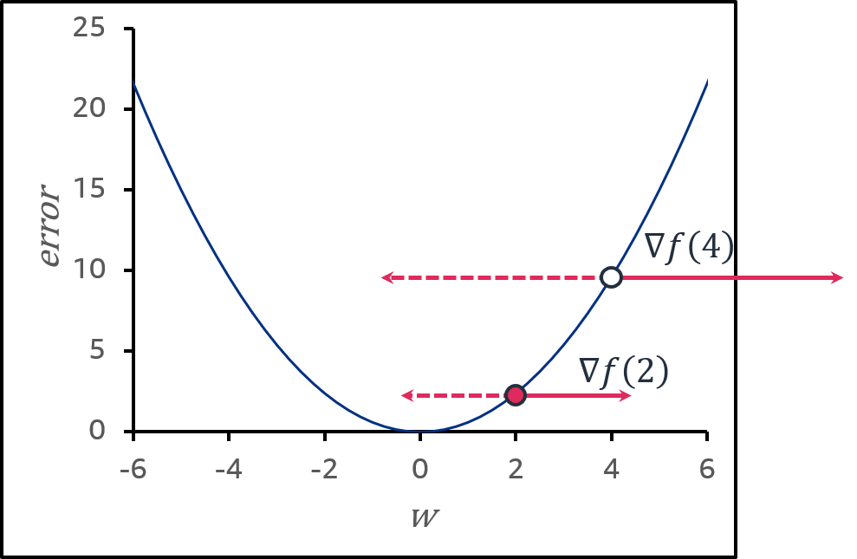

How gradients work mathematically (2 of 4)
$$f\left(w\right)=0.6 w^{2}$$
with gradient vector $∇f\left(w\right)=⟨1.2, w⟩$
The sign of the gradient shows the direction that the function increases: + right and - left
$$∇f\left(2\right)=2.4→\left|∇f\left(2\right)\right|=2.4$$
$$∇f\left(4\right)=4.8→\left|∇f(4)\right|=4.8$$
$$error=f\left(w\right)=0.6w^{2}$$
Notes:
~Equations
~Alt text: Graph of the error function 0.6w^2 with new point at (4, 9.6). See details in notes.
~
Image description: Graph of the error function 0.6w^2. The point and gradient from the previous slide are shown. A new point at (4, 9.6) has +/- gradient vectors to show the direction of the function increase/decrease at that point. End description.
Consider w = 4, grad = +4.8. Again, the sign of the gradient shows the direction that the function increases. You should move to the left to decrease the value of the error function, meaning in the direction the function decreases. This way, getting a smaller size of the gradient,, as the rate of decreasing is lower for this gradient compared with the previous one with w = 4 (depicted by the smaller vector length).

Slide 12
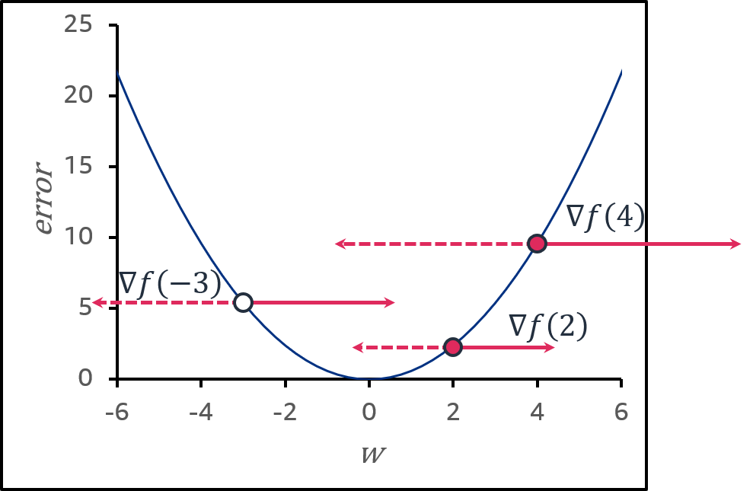

How gradients work mathematically (3 of 4)
$$f\left(w\right)=0.6 w^{2}$$
with gradient vector $∇f\left(w\right)=⟨1.2, w⟩$
The sign of the gradient shows the direction that the function increases: + right and - left
$$∇f\left(2\right)=2.4→\left|∇f\left(2\right)\right|=2.4$$
$$∇f\left(4\right)=4.8→\left|∇f(4)\right|=4.8$$
$$∇f\left(−3\right)=−3.6→\left|∇f\left(4\right)\right|=3.6$$
As you go toward the bottom part of the function, the gradient gets smaller.
$$error=f\left(w\right)=0.6w^{2}$$
Notes:
~Equations
~Alt text: Graph of the error function 0.6w^2 with new point at (3, 4.8). See details in notes.
~
Image description: Graph of the error function 0.6w^2. Points and gradients from the previous slides are shown. A new point at (3, 4.8) has +/- gradient vectors to show the direction of the function increase/decrease at that point. End description.
Try w = -3, grad = -3.6. Now the sign of the gradient is negative, showing the direction that the function increases to the left. You should take a step proportional to the gradient to the right, so the value of the error function decreases.
Note that as you move toward the bottom part of the function, the gradients get smaller. The grad size at 2 is smaller than at 3 and at 4.

Slide 13
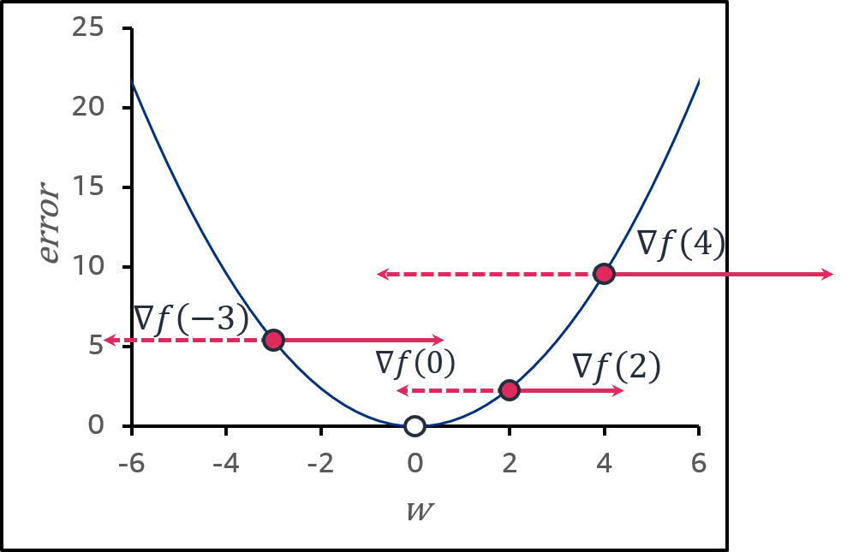

How gradients work mathematically (4 of 4)
$$f\left(w\right)=0.6 w^{2}$$
with gradient vector $∇f\left(w\right)=⟨1.2, w⟩$
The sign of the gradient shows the direction that the function increases: + right and - left
$$∇f\left(2\right)=2.4→\left|∇f\left(2\right)\right|=2.4$$
$$∇f\left(4\right)=4.8→\left|∇f(4)\right|=4.8$$
$$∇f\left(−3\right)=−3.6→\left|∇f\left(4\right)\right|=3.6$$
$$∇f\left(0\right)=0→\left|∇f(0)\right|=0$$
As you go toward the bottom part of the function, the gradient gets smaller.
It eventually becomes zero.
$$error=f\left(w\right)=0.6w^{2}$$
Notes:
~Equations
~Alt text: Graph of the error function 0.6w^2 with new point at (0, 0). See details in notes.
~
Image description: Graph of the error function 0.6w^2. Points and gradients from the previous slides are shown. A new point at (0, 0) doesn’t have gradient vectors because they have a zero length. End description.
As you move toward the minimum of the function, the gradients get smaller and become zero. This means that the function can no longer change (no longer decrease) because it has reached the minimum.
Overall, it seems like a good strategy to move in the opposite direction of the gradient to get to the minimum.
~~~~~~~~~~
\nabla{f}(2) = <2.4> \,\Rightarrow |\nabla{f}(2)| = 2.4
\nabla{f}(-3) = <-3.6> \,\Rightarrow |\nabla{f}(-3)| = 3.6
\nabla{f}(4) = <4.8> \,\Rightarrow |\nabla{f}(4)| = 4.8
\nabla{f}(0) = <0> \,\Rightarrow |\nabla{f}(0)| = 0

Slide 14
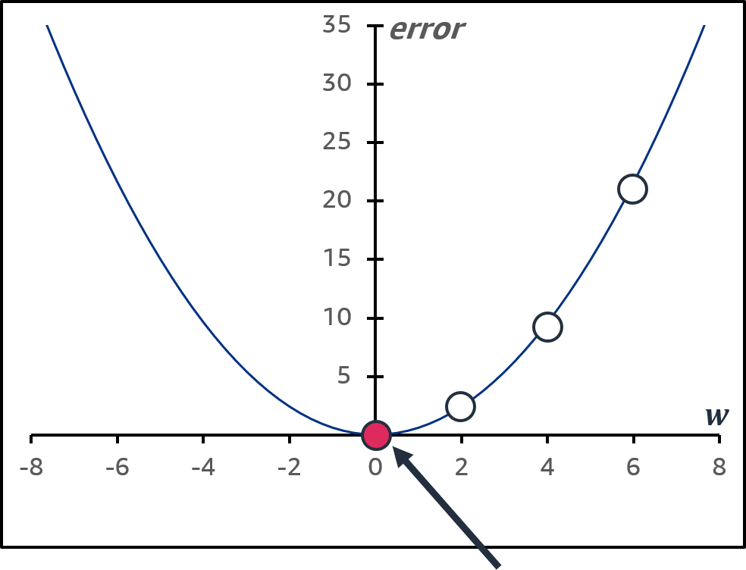
How do you determine how w changes the error?
This is the global minimum. How can you find that without wasting effort on too many guesses?
Notes:
~Alt text: Graph of the gradient function 0.6w^2 with the global minimum at (0, 0) marked.
~
A few questions remain about this method:
How can you get to the minimum without making too many guesses?
How do you know that you’re at the global minimum and not a local minimum?

Slide 15
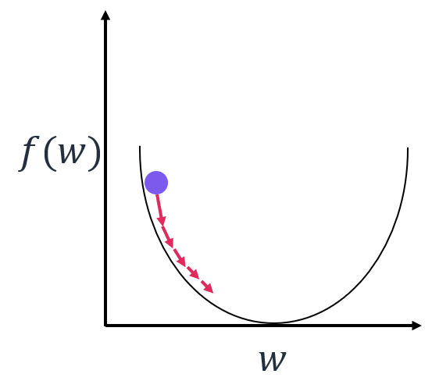

Gradient descent method
Uses gradients to find the minimum of a function iteratively
Takes steps (proportional to the gradient size) toward the minimum, in the opposite direction of the gradient
As the gradient reduces, so do the steps between inputs $(w)$.
This avoids wasted training time.
Gradient descent algorithm:
Start at an initial point $w$
Update: $w_{new}=w_{current}−step size ∗gradient$
Notes:
~Equation
~Alt text: Graph that shows how the gradient descent algorithm takes small steps toward the function’s local minimum.
~
To summarize, this is the gradient descent method. It uses gradients to find the minimum of a function iteratively. Specifically, you take steps that are proportional to the gradient size toward the minimum—in the opposite direction of the gradient.
Gradient descent algorithm: From any initial point w (presumably not at the minimum so the gradient isn’t zero), move toward the min. Update the w by small or large steps in the opposite direction of the gradient.
The size of the update is controlled by the step size parameter, also known as the learning rate. If the step size is too small, the algorithm might take a long time to converge or might never reach the global minimum.
More complicated scenarios can also occur. For example, when the step size is too large, the function might jump back and forth over the minimum and never converge.
~~~~~~~~~~
w_{new} = w_{current} - step\_ size * gradient

Slide 16
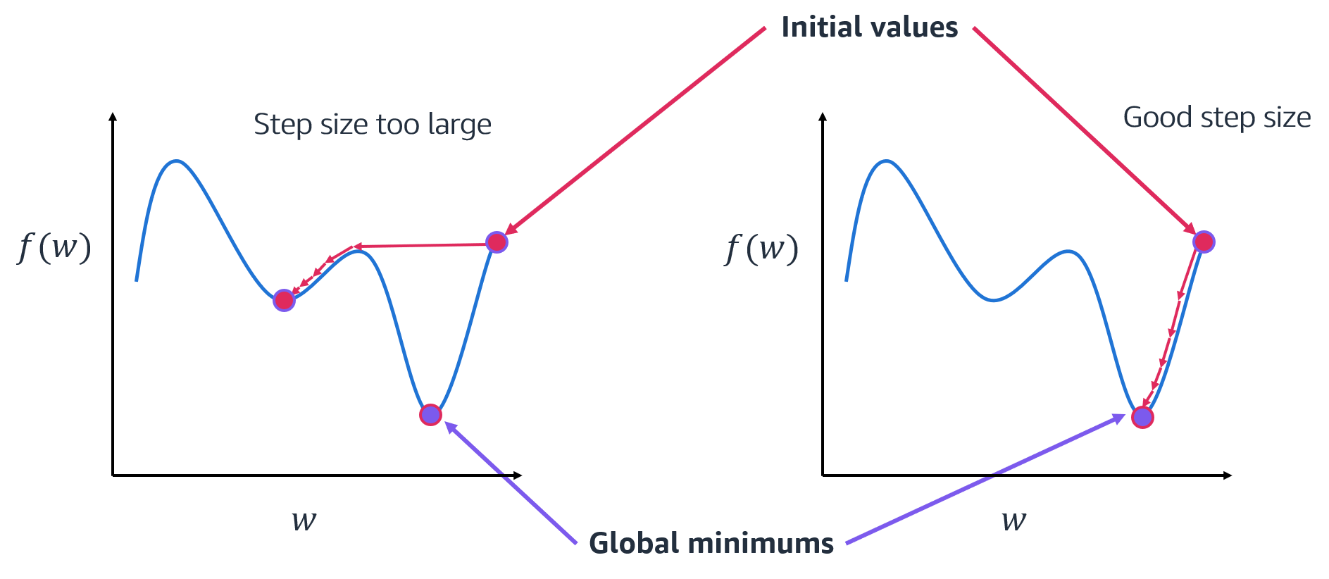
Step size matters
Notes:
~Alt text: Two graphs that show affect of step size. See details in notes.
~
Image description: Left graph shows a function with a local minimum and global minimum. Large gradient steps cause the function to miss the global minimum and settle in the local minimum. Right graph shows the same function with a well-sized gradient step that allows the function to find the local minimum. End description.
In practice, gradient descent is full of surprises, such as the one that is shown here.
If the gradient descent update step size is too large, the algorithm might jump from a good global minimum neighborhood into a not-so-good local minimum neighborhood. It can also go the other way by jumping over a bad local minimum, which would be beneficial. This situation is known as overshooting the minimum.
With a proper learning rate and step size, the jumps will be small enough that you won’t overshoot the minimum. However, unless you have a graph like one of these (which you wouldn’t have in most real scenarios), it will be hard to find that yourself.
A suitable learning rate is difficult to determine. Like with other things in ML, treat the learning rate as a hyperparameter and search for the best value, usually with a validation set.

Slide 17
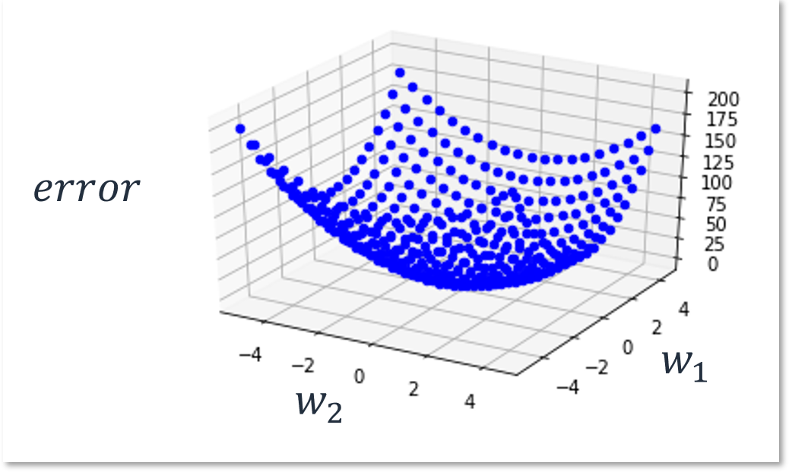
Why can’t you look at the graph to find the global minimum?
$error=f\left(w_{1}, w_{2}\right)=3w_{1}^{2}+5w_{2}^{2}$
If you have two inputs, you can use a three-axis graph.
If you have more than three axes, graphing it becomes virtually impossible.
Notes:
~Equation
~Alt text: 3D error function graph. See details in notes.
~
Image description: 3D error function graph of a function with a minimum that is still easy to see. However, it’s much more complex than the 2D error function graphs in the previous slides. End description.
The more features that your dataset has, the more dimensions that you will need to graph. When you have more than two features, you run out of dimensions to use on an error plot. This makes it exceedingly difficult to visualize, so you must rely on the math to determine the minimum.

Slide 18
Regression models

Slide 19

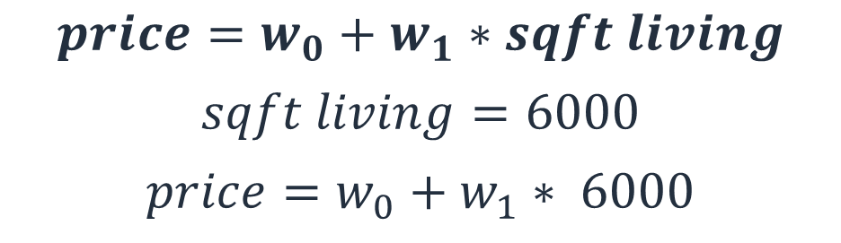
Linear regression
You use (linear) regression for numerical value prediction.
Example: How does the price of a house (target, outcome $y$) change in relation to its square footage of living space (feature, attribute $x$)?
$$price=w_{0}+w_{1}∗sqft living$$
$$sqft living=6000$$
$$price=w_{0}+w_{1}∗ 6000$$
Notes:
~Equations
~
Linear regression is an ML linear model—it’s an ML model that extracts knowledge from data while assuming a linear relationship between the features, or input variables (x), and the target, or single output variable (y).
Linear regression assumes that y can be calculated from a linear combination of the input variables (x). For example, given a house with known sqft_living, compute its sale price simply as a multiplier of the sqft_living. That is sqft_living times w_1, plus some bias w_0 (think of this as some fixed additional charge for buying a house):
price = w_0 + w_1 * sqft_living
The goal of such linear regression is to use it to predict the sale price of any other house, given its sqft_living. For example, for a house with sqft_living = 6000, its sale price would be calculated as follows:
price = w_0 + w_1 * 6000
So, an increase of sqft_living by 1 square foot living increases the price by w_1 dollars. In other words, w_1 is how much each square foot living weights toward the price of the house.
The weights of the linear regression, w_0 and w_1, are called linear regression parameters.

Slide 20

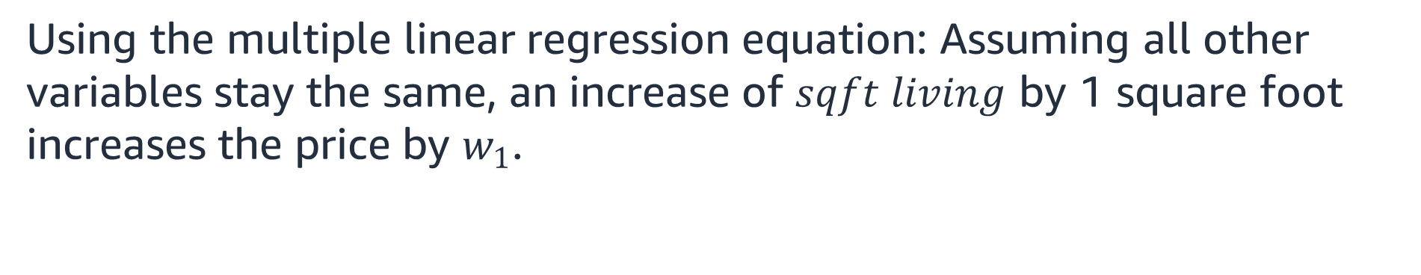
Multiple linear regression
Example: How does the price of a house ($y$) change in relation to its square footage of living space ($x1$) and its number of bedrooms ($x2$)?
That is, using multiple features:
$$price=w_{0}+w_{1}∗sqft living+w_{2}∗bedrooms$$
Using the multiple linear regression equation: Assuming all other variables stay the same, an increase of $sqft living$ by 1 square foot increases the price by $w_{1}$.
Notes:
~Equations
~
Other features of a house might affect the sale price, such as number of bedrooms and ZIP code. As you add more features with their multipliers (weights), the regression equation gets longer. This is traditionally called multiple linear regression.
Using the multiple linear regression equation, assuming that all other variables stay the same, an increase of sqft_living by 1 foot square increases the price by w_1.
What exactly are the weights? You need them to actually compute that predicted sale price based on the existing features of a house.
The key idea behind regression is that the weights will be learned from the data, which means that the regression equation will be learned from the data.

Slide 21
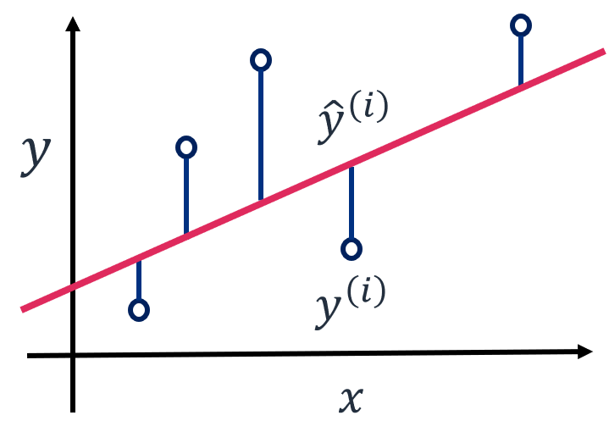
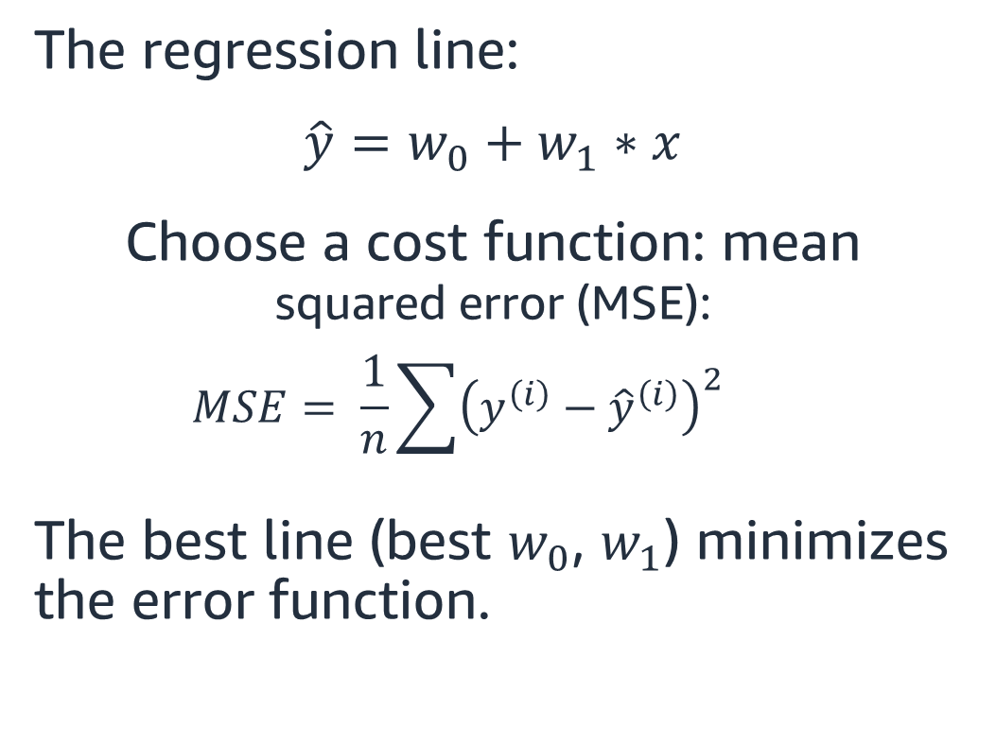
Linear regression: Example calculation
The regression line:
$${\hat{y}=w}_{0}+w_{1}∗x$$
Choose a cost function: mean squared error (MSE):
$$MSE= \frac{1}{n}\sum{{\left(y^{\left(i\right)}−{\hat{y}}^{\left(i\right)}\right)}^{2}}$$
The best line (best $w_{0}$, $w_{1}$) minimizes the error function.
Notes:
~Equations
~Alt text: Plot of the linear function. See details in notes.
~
Image description: Plot of the linear function with sample points. Shows how error is computed by measuring the difference between the true label and predicted value for all the points. End description.
Consider this example of linear regression with one feature, x. It’s easier to visualize and understand the learning mechanism because the regression equation is the equation of a line, meaning that the regression model is also a line.
Given some data points (x_is, y_is), the key idea behind regression is that these data points regress toward a line. The equation of that line—the regression line, the regression equation—can be learned from these data points. The regression line is defined by its w0 (intercept) and w1 (slope). This means that the intercept and the slope are learned from the data.
How does the model learn the regression line (or its weights w0 and w1) from the data?
The goal of a good regression model, like any other ML model, is to match the target as close as possible. The best regression line would best fit the data points. Geometrically, this means that you want to find the line that is as close as possible to all data points by:
Considering that a line drawn far away from the data points would be a bad fit, with large errors.
Considering that the errors are the vertical offsets from each data point y_i to the regression line y_hat_i (the model predictions).
Bringing the line closer to the data points by changing the intercept (w0) and slope (w1).
Lowering the overall sum of all the vertical offsets to get a better regression line, with a better fit to the data.
Giving negative errors a chance to meaningfully contribute to the overall error, taking the sum of squared vertical offsets.
The best regression line would be the line that minimizes the mean squared error (MSE). Because the regression line is described by the weights w0 and w1, the best w0 and w1 would minimize the MSE.
The way to learn a regression model is to minimize an error function. One way to do this is by using the gradient descent method.

Slide 22
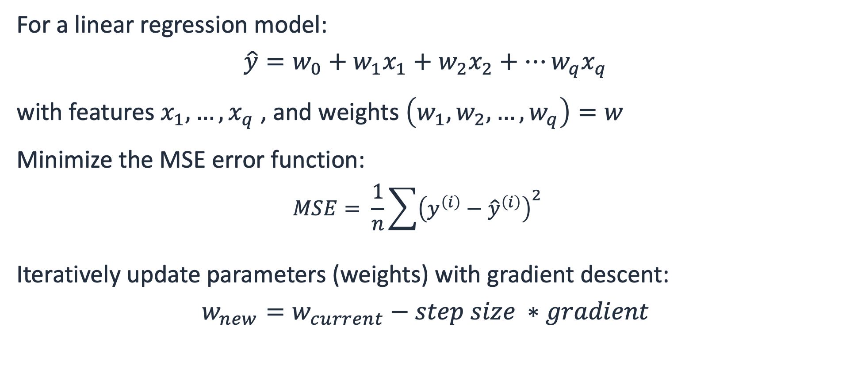
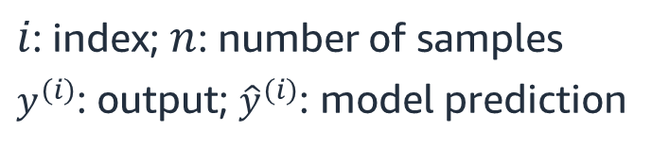
Fitting a linear regression model: Gradient descent
For a linear regression model:
$$\hat{y}=w_{0}+w_{1}x_{1}+w_{2}x_{2}+…w_{q}x_{q}$$
with features $x_{1}, …, x_{q}$ , and weights $\left(w_{1},w_{2}, …, w_{q}\right)=w$
Minimize the MSE error function:
$$MSE= \frac{1}{n}\sum{{\left(y^{\left(i\right)}−{\hat{y}}^{\left(i\right)}\right)}^{2}}$$
Iteratively update parameters (weights) with gradient descent:
$$w_{new}=w_{current}−step size ∗gradient$$
$i$: index; $n$: number of samples
$y^{(i)}$: output; ${\hat{y}}^{(i)}$: model prediction
Notes:
~Equations
~
Summary of the gradient descent process:
Given data features (x1, …, xq) and output y, try to learn a linear relationship between y and (x1, …, xq) such as y = w0+w1*x1+w2*x2+…+wq*xq
Start with the initial choice of all w’s that are stored in this w vector.
Examine the averaged sum of squares error and the MSE that are large (for a poorly fit model).
Compute the MSE with respect to the w, and use the MSE to update the vector w.
After a few iterations, you should have a better regression model that makes predictions closer and closer to the given training data points.
Note that, given data that consists of features and an output, the learned linear regression model is a collection of weights—learned numerical values collected into the vector w.
When you need to use the trained regression model for predictions on a new data point with its set of features, use these weights as multipliers on the features to produce the desired prediction.
~~~~~~
\hat{y} = w_0 + w_1 x_1 + w_2 x_2 + … + w_q x_q
MSE = \frac{1}{n}\sum_{i=0}^{n}(y^{(i)}-\hat{y}^{(i)})^2
\textbf{w}_{new} = \textbf{w}_{current} - step\_ size * gradient
x_1,..., x_q
(w_0, w_1, …, w_q) = \textbf{w}

Slide 23
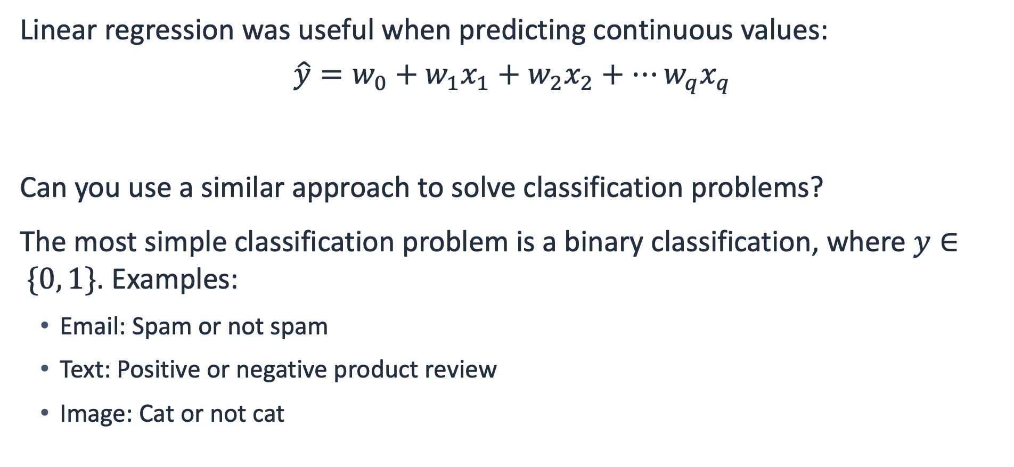
From regression to classification
Linear regression was useful when predicting continuous values:
$$\hat{y}=w_{0}+w_{1}x_{1}+w_{2}x_{2}+…w_{q}x_{q}$$
Can you use a similar approach to solve classification problems?
The most simple classification problem is a binary classification, where $y∈ \{0, 1\}$. Examples:
Email: Spam or not spam
Text: Positive or negative product review
Image: Cat or not cat
Notes:
~Equations
~
What if you wanted to know how much a particular feature of a house affects whether the house is sold. This would be a classification question—more precisely, a binary classification question.
Linear regression is useful to predict continuous values, and learning the regressor by gradient descent seems clever. Can you use a similar approach to solve a classification problem?
Examples of binary classification problems are listed on the slide. With all these scenarios, one problem is that the regression output (y) can take any real value, whereas the output of classification is one class or another (think y = 0 or y = 1).

Slide 24
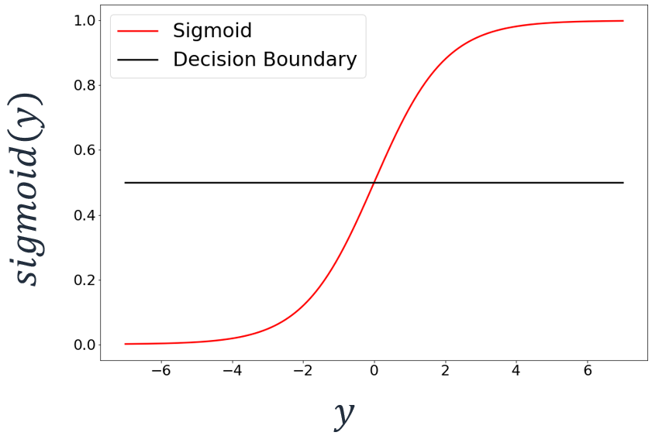


Logistic regression
Idea: Apply the Sigmoid function to $\hat{y}=w_{0}+w_{1}x_{1}+w_{2}x_{2}+…w_{q}x_{q}$
Sigmoid (logistic) function
$$sigmoid\left(y\right)=\frac{1}{1+e^{−y}}$$
“squishes” $y$ values to the 0–1 range.
Can define a “decision boundary” at 0.5:
if $sigmoid\left(y\right)$ < 0.5, round down (class 0)
if $sigmoid\left(y\right)≥$ 0.5, round up (class 1)
The regression equation becomes:
$$sigmoid(w_{0}+w_{1}x_{1}+w_{2}x_{2}+…w_{q}x_{q})$$
Notes:
~Equations
~Alt text: Plot of the sigmoid function. See details in notes.
~
Image description: Plot of the sigmoid function. The function has a property to shrink the value of the input between 0 and 1. The default decision boundary is 0.5 for logistic regression. End description.
One idea to link the regression to classification is to use the sigmoid (logistic) function to “squish” the values that come from regression to a range from 0 to 1. Think of these new values as class probabilities. The closer the value is to 0, the more likely that it belongs to class 0; the closer to 1, the more likely that it belongs to class 1. To decide on points in the middle, define a decision boundary at 0.5 to extract class assignments from the 0–1 probabilities range. Anything less than 0.5 assigns to class 0, and anything more than 0.5 assigns to class 1.
The classifier uses regression outputs to the sigmoid (logistic) function and is defined by the sigmoid equation. The classifier is appropriately called logistic regression.
If this is the classifier, how do you learn the best classifier? Would it work the same as with regression? Would it start with an initial weak classifier (some choice of w’s)? Would you then examine the value of an error function and update the w’s by using gradient descent, until it is a better classifier? What would that error function be?

Slide 25
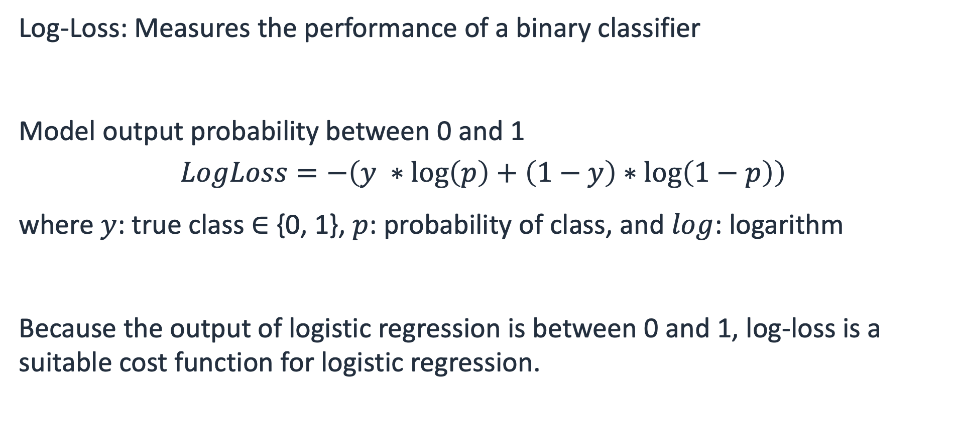
Log-loss (binary cross-entropy)
Log-Loss: Measures the performance of a binary classifier
Model output probability between 0 and 1
$$LogLoss=−\left(y ∗\log\left(p\right)+\left(1−y\right)∗\log\left(1−p\right)\right)$$
where $y$: true class $∈$ {0, 1}, $p$: probability of class, and $log$: logarithm
Because the output of logistic regression is between 0 and 1, log-loss is a suitable cost function for logistic regression.
Notes:
~Equations
~
You need a loss function that can quantify how close the classifier output (p) is to the true class (y, which is 0 or 1).
The LogLoss function (also known as binary cross-entropy loss) is a suitable loss function for logistic regression. Therefore, to improve a logistic regression model’s learning from data, you want to minimize the log-loss.
The LogLoss function is not as intuitive as the sum of squares error. You can test whether closer predictions produce lower LogLoss values to ensure that monitoring and minimizing this LogLoss function will indeed lead to an overall better model.

Slide 26
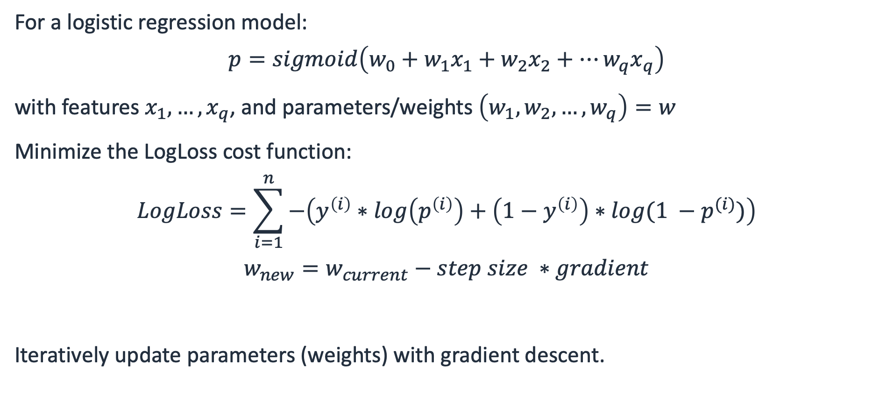
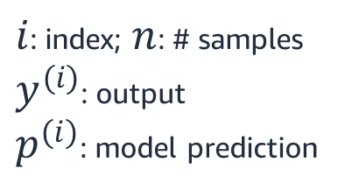
Fitting a logistic regression model: Gradient descent
For a logistic regression model:
$$p=sigmoid\left(w_{0}+w_{1}x_{1}+w_{2}x_{2}+…w_{q}x_{q}\right)$$
with features $x_{1}, …, x_{q}$, and parameters/weights $\left(w_{1},w_{2}, …, w_{q}\right)=w$
Minimize the LogLoss cost function:
$$LogLoss=\sum_{i=1}^{n}{−\left(y^{\left(i\right)}∗\log\left(p^{\left(i\right)}\right)+\left(1−y^{\left(i\right)}\right)∗log⁡(1 −p^{(i)})\right)}$$
$$w_{new}=w_{current}−step size ∗gradient$$
Iteratively update parameters (weights) with gradient descent.
$i$: index; $n$: # samples
$y^{(i)}$: output
$p^{(i)}$: model prediction
Notes:
~Equations
~
Interpreting the weights in logistic regression differs from interpreting the weights in linear regression because the weights don’t influence the output linearly any longer. Still, when you need to use the trained log regression model to predict on a new data point with its set of features, use the logistic weights as multipliers on the features. Transform the weighted sum with the logistic function to a probability and produce the desired class prediction by using a decision threshold.
You can extend linear and logistic regression to handle nonlinear regression or classification problems by incorporating new features that are based on the interactions between existing features or higher order terms.

Slide 27
Regression models: Summary
Pros:
Interpretable and computationally efficient
Reliable and robust baselines; can achieve good performance
Building blocks for more advanced techniques
Can be adjusted to handle nonlinearities
Cons:
Requires some assumptions on data distribution; affected by outliers
Prone to underfit on nonlinear data
Prone to overfit when overadjusted to handle nonlinearities

Slide 28
Regularization

Slide 29
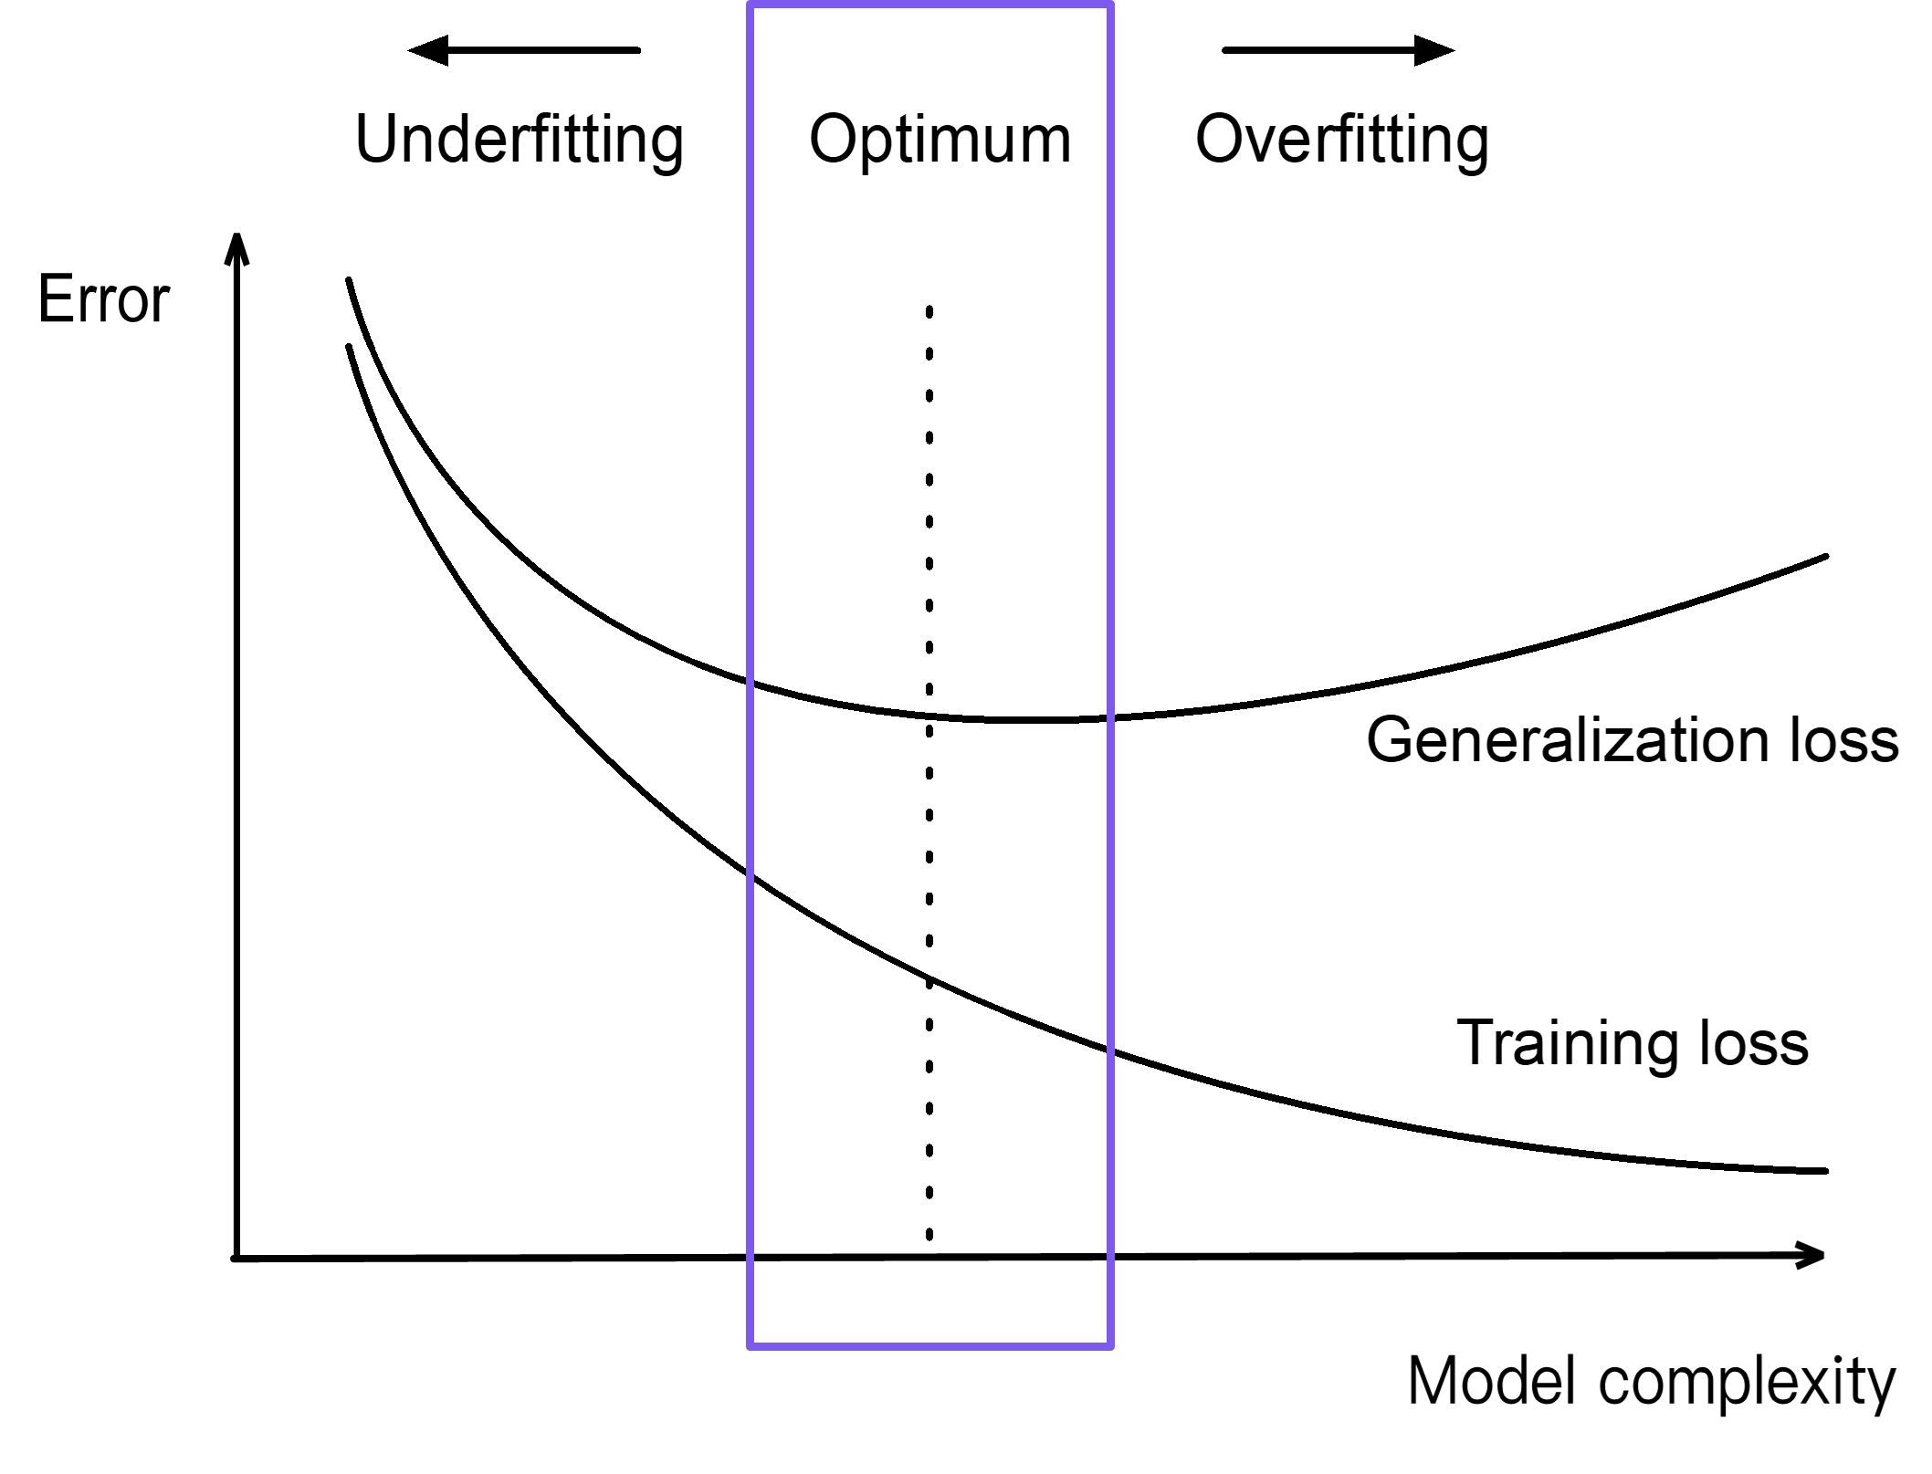
Underfitting, overfitting, and regularization
Underfitting: Model too simple
Overfitting: Model too complex
Optimum: Compromise between fit and complexity (drop features, reduce weights)
Regularization does both: Penalize large weights; sometimes reduce all the way to 0
Notes:
~Alt text: Graphic of relationship between complexity and error. See details in notes.
~
Image description: Graphic to show how models tend to overfit with increasing complexity. Initially, the error decreases for training loss and generalization loss. However, after a point, the training loss continues to reduce while the generalization loss increases. This indicates that the model is overfitting. End description.
Consider overfitting, underfitting, and “good fit” in regression models, such as a nonlinear logistic regression model.
Remember that a learned (linear or logistic) regression model is a collection of weights—a w vector.
Underfitting occurs when not enough learning was done. The model is usually too simple. Maybe it considers fewer features, or maybe some features contribute little to the model, so their multipliers (weights) are small.
Losses plots: Underfitting models don’t usually perform well on the training dataset. In turn, they don’t perform well on future similar datasets, such as the validation or test datasets.
Think of an underfitting model as a collection of weights. The w vector would have many zeros (meaning that most features don’t contribute or have an impact) or would have small values (meaning that features have little to say).
Overfitting occurs when too much learning was done. The model is usually too complex and might consider all features. This might include some complex nonlinear combination of features, with most features having a strong voice or large weights.
Losses plots: Overfitting models usually perform well on the training dataset, and learn every detail and noise in the training data. This can negatively impact the performance of the model on future data. These models don’t generalize well to new data—they merely memorize the training data. Think of an overfitting model as a collection of weights. The w vector would be larger in size or contain larger values.
With this perspective:
Overfitting model = w vector, large size, large values = the best fit
Underfitting model = w vector, small size, small values, many zeros = the best complexity (if you consider simpler to be better)
You can provision a “good fit” model—a regular model—as a compromise model. Conceptually, it is a compromise between fit and complexity. It has the weights vector w somewhere between as size and values go, not too few or too many features, and not too small or too large weights.

Slide 30
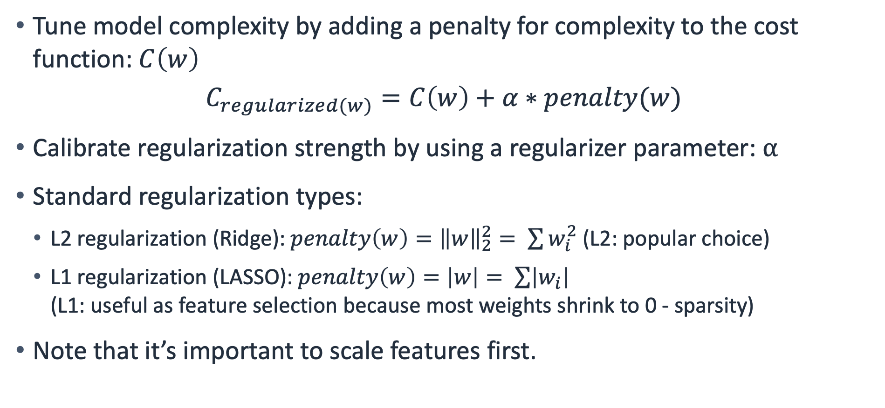
Regularization
Tune model complexity by adding a penalty for complexity to the cost function: $C\left(w\right)$
$$C_{regularized(w)}=C\left(w\right)+α∗penalty(w)$$
Calibrate regularization strength by using a regularizer parameter: $α$
Standard regularization types:
L2 regularization (Ridge): $penalty\left(w\right)={\left\|w\right\|}_{2}^{2}= \sum{w_{i}^{2}}$ (L2: popular choice)
L1 regularization (LASSO): $penalty\left(w\right)=\left|w\right|= \sum{\left|w_{i}\right|}$ (L1: useful as feature selection because most weights shrink to 0 - sparsity)
Note that it’s important to scale features first.
Notes:
~Equations
~
How does regularization penalize large weights?
Weights are learned by minimizing an error function—here C(w) with respect to w, aiming for the best fit of the model to the data.
Think of it as aiming for best complexity where some complexity function could also be minimized with respect to w. That function is traditional called a penalty in ML.
To regularize an ML model, you minimize the extended error (cost) regularized function of w to get a simpler model:
Minimize the original error (cost) function for a good fit.
At the same time, minimize the complexity of the model.
You can use the regularizer parameter to calibrate or control the strength of the regularization:
If alpha = 0, no penalty for complexity is applied (the model will concentrate on the best fit alone; probably overfitting by driving the errors as low as possible).
If alpha is too big, the complexity penalty is strong, leading to simple models (probably underfitting models).
It’s difficult to know what the best value of alpha is for your data and model.
Treat alpha as a hyperparameter—select the best value by using a validation set or k-fold CV.
Ridge regression (L2 regularization): Penalizes the model by minimizing the sum of the squared values of all feature weights. Tries to uniformly make all weights smaller but doesn’t necessarily drive them to zero. For more information, see Ridge Regression on Wikipedia at https://en.wikipedia.org/wiki/Ridge_regression.
Lasso (least absolute shrinkage and selection operator) regression (L1 regularization): Penalizes the sum of the absolute values of all feature weights, shrinking some weights all the way to 0, because of the geometry of the L1 norm/abs value. Therefore, L1 regularization performs feature selection. If weights are learned to be zero, then the corresponding features were deemed unnecessary—the model won’t use them. For more information, see Lasso (Statistics) on Wikipedia at https://en.wikipedia.org/wiki/Lasso_(statistics).
As with any other metric-based procedure, to avoid any scaling issues remember to scale your features first, before regularization.

Slide 31
Regression in sklearn
LinearRegression: sklearn linear regression (and regularization)
LinearRegression()
Ridge(alpha=1.0), RidgeCV(alpha=1.0, cv=5)
Lasso(alpha=1.0), LassoCV(alpha=1.0, cv=5)
LogisticRegression: sklearn logistic regression (and regularization)
LogisticRegression(penalty='l2', C=1.0, l1_ratio=None)
LogisticRegressionCV(penalty='l2', C=1.0, l1_ratio=None, cv=5)
Notes:
~Equations
~
Now that you know some techniques to learn the coefficients in a linear or logistic regression model, and how to adjust overfitting or underfitting models, you will learn how to use regression models in practice with sklearn.
Sklearn has a few linear regression implementations:
LinearRegression: Fits a linear model by computing a solution to minimize sum of squares error by using matrix formulas. Runs into issues when features are highly correlated, producing large variance in results. For more information, see the sklearn LinearRegression documentation at https://scikit-learn.org/stable/modules/generated/sklearn.linear_model.LinearRegression.html.
Ridge: Addresses some problems of linear regression by imposing an L2 penalty (regularization is applied by default). The regularizer parameter, α ≥ 0, controls the amount of regularization: the larger the value of α, the greater the amount of regularization or shrinkage, and thus the coefficients become more robust to collinearity. For more information, see the sklearn Ridge documentation at https://scikit-learn.org/stable/modules/generated/sklearn.linear_model.Ridge.html.
RidgeCV: Implements ridge regression with built-in cross-validation of the alpha parameter (cv = 5). For more information, see the sklearn RidgeCV documentation at https://scikit-learn.org/stable/modules/generated/sklearn.linear_model.RidgeCV.html.
If you would rather try an L1 penalty, Lasso and LassoCV are also available. For more information, see the sklearn Lasso documentation at https://scikit-learn.org/stable/modules/generated/sklearn.linear_model.Lasso.html.
LogisticRegression, and LogisticRegressionCV with built-in cross-validation:
All regularizations are done by a penalty parameter.
Regularization is applied by default and uses a slightly different regularizer parameter that is attached to the cost function, not the penalty.
C = 1/alpha. The larger the value of C, the lower the amount of regularization.

Slide 32

Next lesson
The next lesson will describe how to select hyperparameters to improve a model’s performance.
See you next time!

Slide 34
Image source slide (for curriculum development use only)

Slide 35
Source graphic: Optimization in ML
Features
Rules
Target
Difference = error
Features
Rules
Prediction
Notes:
~Source for slide 4

Slide 36

Source graphic: How do you determine how w changes the error?
$$w$$
Notes:
~Source for slide 6

Slide 37
Source graphic: What about w = 6?
$$w$$
Notes:
~Source for slide 7

Slide 38
Source graphic: What about w = 2?
$$w$$
Notes:
~Source for slide 8

Slide 39
Source graphic: What is happening here?
$$w$$
Notes:
~Source for slide 9

Slide 40

Source graphic: How gradients work mathematically (1 of 4)
$$∇f\left(2\right)$$
Notes:
~Source for slide 10

Slide 41

Source graphic: How gradients work mathematically (2 of 4)
$$∇f\left(4\right)$$
$$∇f\left(2\right)$$
Notes:
~Source for slide 11

Slide 42

Source graphic: How gradients work mathematically (3 of 4)
$$∇f\left(4\right)$$
$$∇f\left(−3\right)$$
$$∇f\left(2\right)$$
Notes:
~Source for slide 12

Slide 43

Source graphic: How gradients work mathematically (4 of 4)
$$∇f\left(4\right)$$
$$∇f\left(−3\right)$$
$$∇f\left(0\right)$$
$$∇f\left(2\right)$$
Notes:
~Source for slide 13

Slide 44
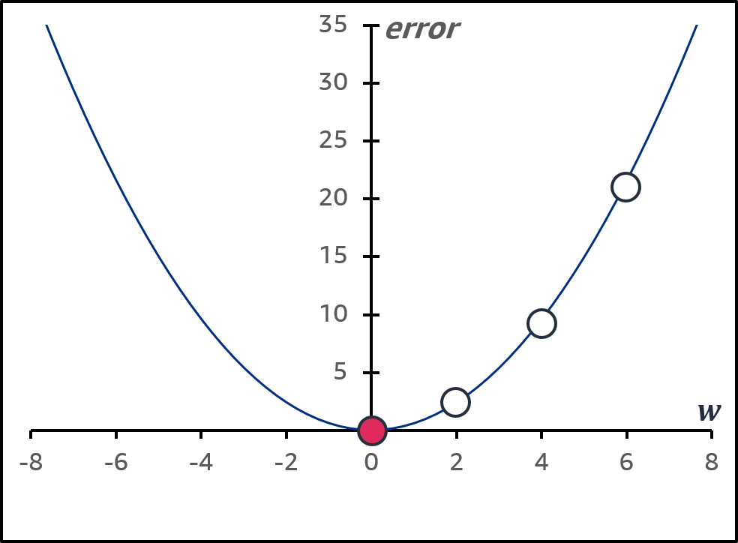

Source graphic: How do you determine how w changes the error?
$$w$$
Notes:
~Source for slide 14

Slide 45


Source graphic: Gradient descent method
$$f(w)$$
$$w$$
Notes:
~Source for slide 15

Slide 46




Source graphic: Step size matters
Initial values
Step size too large
Good step size
$$f(w)$$
$$f(w)$$
$$w$$
$$w$$
Global minimums
Notes:
~Source for slide 16

Slide 47
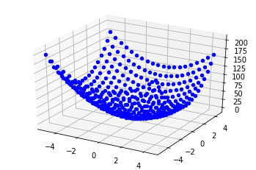



Source graphic: Why can’t you look at the graph to find the global minimum?
$$error$$
$$w_{1}$$
$$w_{2}$$
Notes:
~Source for slide 17

Slide 48




Source graphic: Linear regression: Example calculation
$${\hat{y}}^{\left(i\right)}$$
$$y$$
$$y^{\left(i\right)}$$
$$x$$
Notes:
~Source for slide 21

Slide 49
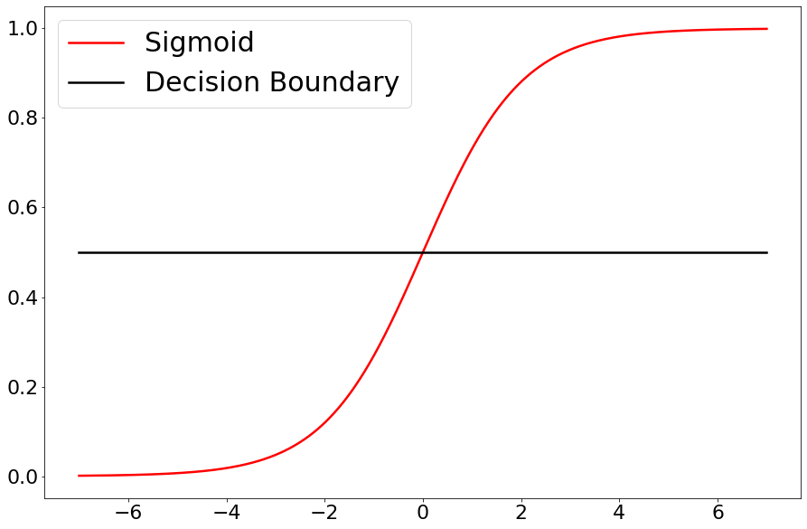


Source graphic: Logistic regression
$$sigmoid\left(y\right)$$
$$y$$
Notes:
~Source for slide 24

Slide 50
Source graphic: Underfitting, overfitting, and regularization
Notes:
~source for slide 30

