Slide 1
Designing Fair Models, and Data Integrity and Analysis
Machine Learning through Application
Module 3 – Lesson 2

Slide 2
Today’s activities
Human-centered design (HCD) to formulate fair models
Data integrity and documentation
Exploratory data analysis and quantifying bias
Notes:
This lesson will cover the topics that are listed.

Slide 3
Designing fair models

Slide 4


HCD
Human perspective
Human impact
Human-centered design (HCD) focuses on the human perspective when developing products, systems, and services.
HCD emphasizes that AI systems and ML solutions should consider the impact on humans.
Notes:
To help with the design of fair models, it is important to consider how the AI system will impact humans. Human-centered design (HCD) is an approach that aims to make (AI) systems relevant to the users, by asking questions to clarify their needs and requirements. HCD also considers the risks AI can pose.

Slide 5
HCD for AI systems
Considerations for using AI
Design elements when using AI
Potential harms
Will the use of ML technology be beneficial for the use case?
Will the AI system reinforce stereotypes?
Value proposition
Is AI necessary, or can a simple, interpretable rule-based system achieve the same purpose?
Safety measures
Continuously test and evaluate the system.
Ways to challenge the model and the ML pipeline
Include ways for users to report unexpected behavior.
Notes:
Human-centered design (HCD) is a big area of research. The main goal of HCD for AI is to ask questions about potential harms and risk, as well as the value proposition of using AI. From a practical design point, you should ensure that safety measures are in place for AI systems. You should also include mechanisms to allow end users to challenge unexpected model behavior and outcomes.

Slide 6
Data integrity

Slide 7
Where does unwanted bias in data come from?
Biased sampling
Avoid sampling methods that systematically overrepresent or underrepresent certain groups. Examples:
Selection bias: Using samples from a different distribution
Measurement bias: Using different measuring devices or techniques
Confirmation bias: Wrongly discarding outliers to match existing beliefs
Issues with the quality of features and labels
Avoid using data that perpetuates existing biases (tainted data) and indirect measurements. Example:
Historical bias: Using samples from society that are known to be biased
Notes:
Bias in the outputs of ML models can stem from bias in the training data that algorithms learn from. Bias in the training data can be because of different effects. For example, biased sampling methods might lead to a skewed representation, or features could be of low quality or not reproducible.

Slide 8
Better data integrity can reduce bias in the data
To ensure data integrity, address these two factors:
Data quality: Select meaningful, high-quality features. Verify quality of labels (check for historical bias).
Data sampling: Use valid, fair sampling and storage techniques (check for consent and avoid data duplication).

Slide 9
Characteristics of high-quality data
High-quality data is robust and objective. Data should meet these criteria:
Is quantifiable: Features are true measurements of certain characteristics. For example, the number of messages between peers (direct measurement) rather than a “connectedness” score (subjective score).
Can be measured directly: Features are not outputs of another model or compounds of different features.
Is understandable: The feature name should be easy to understand. For example, monthly_bonus, rather than mb.
Notes:
Data should be reproducible and not depend on who recorded it. If the data quality is poor, then the model may end up perpetuating existing biases or even amplify the bias. It is therefor very important to ensure that the data quality is as high as possible.

Slide 10
Biased datasets in NLP and CV
Historical and societal bias is often present in data collected from the “wild.”
Example: Research showed that word embeddings can encode societal stereotypes.
Geographical representation is not equal for many of the most widely used computer vision (CV) datasets.
Example: ImageNet is used to train neural networks for image classification, and it has more than 15 million labeled images. However, they come from only a few nations.
Notes:
The following acronym is used on this slide:
NLP: natural language processing
References:
Tolga Bolukbasi, Kai-Wei Chang, James Zou, Venkatesh Saligrama, and Adam Kalai, “Man Is to Computer Programmer as Woman Is to Homemaker? Debiasing Word Embeddings,” arXiv (July 2016). https://doi.org/10.48550/arXiv.1607.06520.
Shreya Shankar, Yoni Halpern, Eric Breck, James Atwood, Jimbo Wilson, D. Sculley, “No Classification without Representation: Assessing Geodiversity Issues in Open Data Sets for the Developing World,” arXiv (November 2017). https://doi.org/10.48550/arXiv.1711.08536.

Slide 11
Challenges to label quality
Tainted labels
Imprecise labels
Labels generally describe what happened historically but don’t tell you what the unbiased outcome would have been.
To mitigate bias, you need to address the underlying causes of inequality: bias-transforming metrics.
Labels can be insufficiently precise to capture meaningful differences between cases.
To mitigate bias, collect additional information or clean labels before passing them to an ML model.
Notes:
History is full of examples of disparate outcomes for different groups. If you train on past biased decision-making, you might encode the historical, societal, or geographical bias. Therefore, it’s important to think about the patterns that led to biased outcomes to begin with.
References:
Solon Barocas and Andrew D. Selbst, “Big Data’s Disparate Impact,” California Law Review 104, no. 3. (June 2016): 671–732, http://dx.doi.org/10.15779/Z38BG31.
Sandra Wachter, Brent Mittelstadt, and Chris Russell, “Bias Preservation in Machine Learning: The Legality of Fairness Metrics under EU Non-discrimination Law,” West Virginia Law Review 123, no. 3. (2021): 2–51, https://researchrepository.wvu.edu/wvlr/vol123/iss3/4.

Slide 12
Datasheets for datasets
A datasheet is a record of the main characteristics of data and use case and limitations.
You might find the following information in a datasheet:
Who collected the data
What purpose the data was collected for
When and where the data was collected
How the data was collected
Descriptive statistics of the dataset
Notes:
A datasheet tries to capture all the important information about a dataset that is used to train a model. To complete a datasheet, you must answer several important questions—many of which can help to identify bias before the model is even trained.

Slide 13
Exploratory data analysis

Slide 14
Exploratory data analysis (EDA)
EDA is an approach to analyze a dataset and capture its main characteristics. EDA can help you find correlations, missing data, and skewed distributions.
Different EDA techniques are used to identify bias in the data, and other techniques are used to explore data in general:
General ML: Perform initial investigations to discover patterns, spot anomalies, test the hypothesis, and check assumptions.
Responsible ML: Identify data collection gaps, inform further feature processing, and detect societal and historical bias.
Notes:
Exploratory data analysis (EDA) is important in ML in general, as it can help you understand what kind of algorithm would be required to solve the ML problem. EDA is also relevant to identify bias in the dataset by looking for correlations and data skews. EDA includes the creation of summary statistics and graphical representations of data (such as histograms and plots).

Slide 15
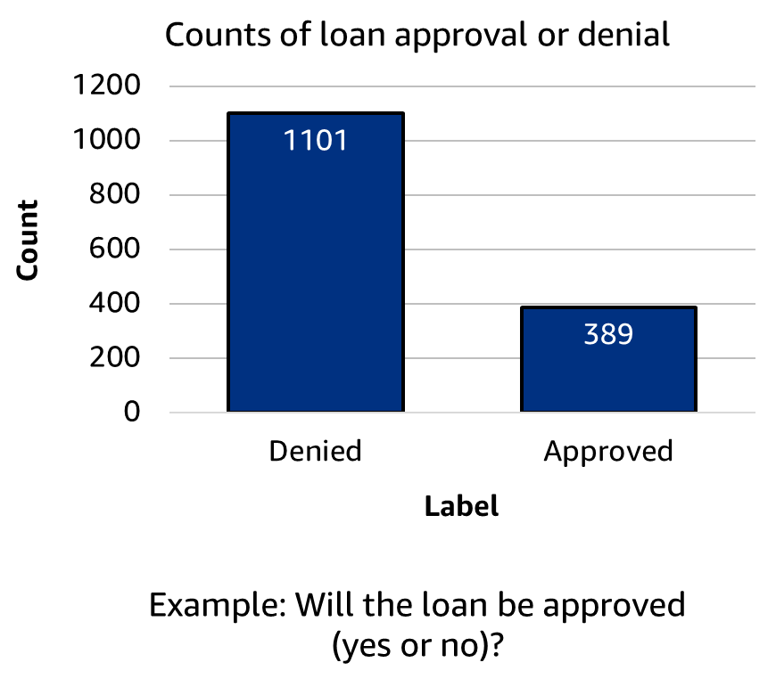
Label imbalance: Loan approval example
The outcome classes are not equally distributed.
Models often assume an equal distribution of classes.
High accuracy paradox: If a model works well for the majority class, it is considered accurate.
It’s especially bad if one outcome type is also overrepresented in one group.
Notes:
~ Alt text: Bar chart showing outcomes for loan applications. There are approximately three times as many denied outcomes as approved.
~
As part of EDA, you can analyze the distribution of the labels. Samples per class might not be equally distributed, and the ML model might not work well for the infrequent labels. In the chart on the slide, more data points are available for the “denied” label.
Models learn from data, so by seeing more negative outcomes, the model might predict more negative outcomes in general. This can be especially bad if one group of people is overrepresented in a certain outcome class.

Slide 16
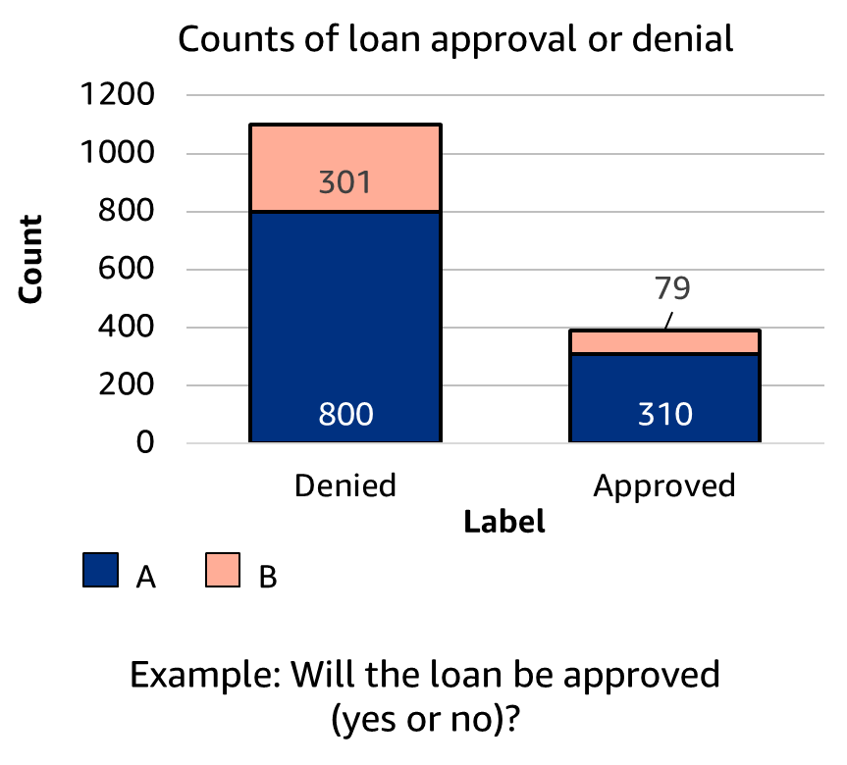
Group-wise label imbalance: Loan approval example
Consider the outcomes (labels) per group.
Beware of biased sampling, and check for minority groups in the dataset.
General ML measures exist to quantify label imbalance.
Responsible ML measures exist to quantify imbalance per subpopulation.
Notes:
~Alt text: Bar chart of loan application outcomes. See details in notes.
~
Image description: Bar chart showing denied and approved outcome for loan applications split by two groups, A and B. Group B has a worse ratio of approved outcomes than group A. End description.
Group imbalance can pose an additional complication—especially when negative outcomes are disproportionally concentrated in one group. Therefore, you should visualize and quantify outcomes (labels) per group.

Slide 17
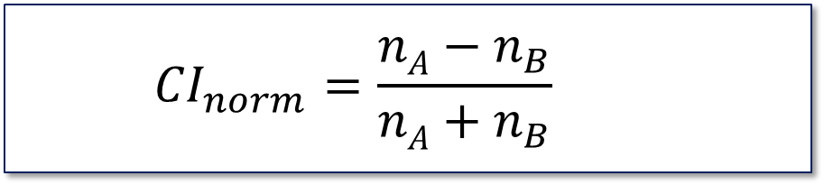

Quantifying imbalance: Samples
Normalized class imbalance (${CI}_{norm}$): Measures imbalance in the number of data examples (count), n, between two subpopulations, A and B
$${CI}_{norm}=\frac{nA−n_{B}}{nA+n_{B}}$$
Positive CI values indicate that group A has more data points.
∈ [-1,1]
Notes:
~Equations
~
Class imbalance (CI) works to assess the imbalance in group sizes.
Positive CI values indicate that group A has more training samples in the dataset, and a value of 1 indicates that the data only contains members of group A.
Values of CI that are near zero indicate a more equal distribution of members between groups. A value of zero indicates a perfectly equal partition between groups and represents a balanced distribution of samples in the training data.
Negative CI values indicate that group B has more training samples in the dataset, and a value of -1 indicates that the data only contains members of group B.

Slide 18
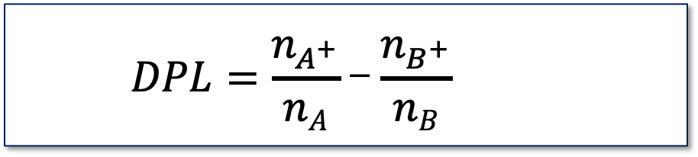

Quantifying imbalance: Labels
Difference in proportions of labels ($DPL$): Measures the difference in the fraction of positive outcomes for two subpopulations, A and B
$$DPL=\frac{n_{A^{+}}}{nA}\text{−}\frac{n_{B^{+}}}{nB}$$
Positive DPL values indicate that the examples in group A have more positive outcomes.
∈ [-1,1]
Notes:
~Equations
~
For more metrics, see “Measure Pre-training Bias” in the Amazon SageMaker Developer Guide at https://docs.aws.amazon.com/sagemaker/latest/dg/clarify-measure-data-bias.html.
Difference in proportion of labels (DPL) is specifically used to assess label distribution.
Another metric is difference in predicted proportion of labels (DPPL). The equation is the same as for DPL, but the numbers come from model predictions rather than training data. You can often observe a shift for the worse in predicted labels.
Positive DPL values indicate that group A has a higher proportion of positive outcomes when compared with group B.
Values of DPL that are near zero indicate a more equal proportion of positive outcomes between groups. A value of zero indicates perfect demographic parity.
Negative DPL values indicate that group B has a higher proportion of positive outcomes when compared with group A.

Slide 19
Why do we need bias metrics?
Normalized class imbalance: Detect whether there’s enough data for each subpopulation. The outcome might suggest that you need to obtain more data.
Difference in proportions of labels: Detect bias in the dataset. Measure pretraining demographic parity as the baseline.
Many more pretraining metrics exist!

Slide 20
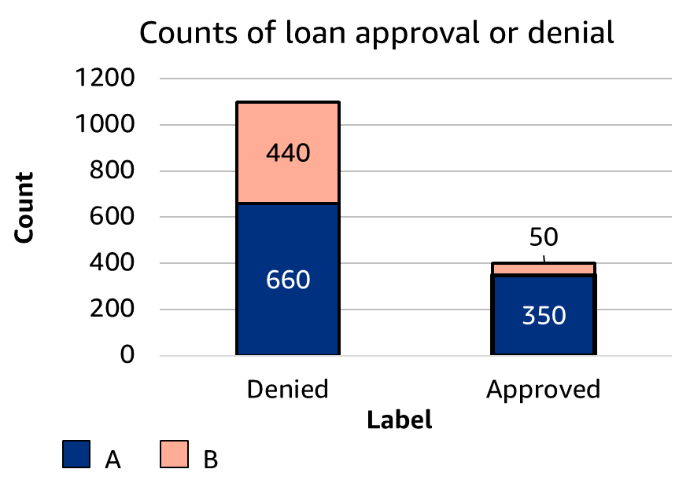
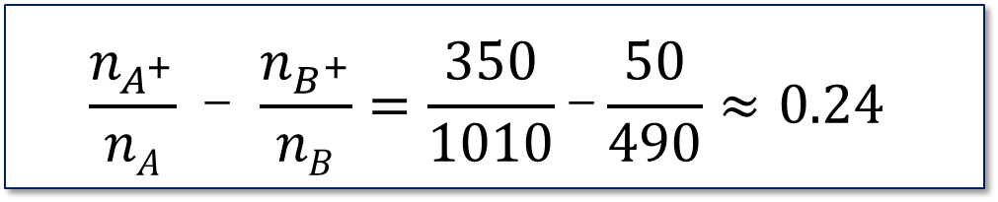
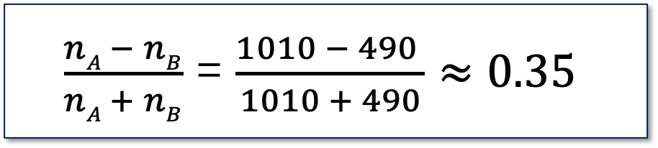
Quantifying imbalance
Normalized class imbalance
$\frac{nA − nB}{nA + nB}$ = $\frac{1010 − 490 }{1010 + 490}≈0.35$
Difference in proportions of labels
$$\frac{n_{A^{+}}}{nA}\text{ − }\frac{n_{B^{+}}}{nB}=\frac{350}{1010}\text{−}\frac{50}{490}≈0.24$$
Notes:
~Equations
~Alt text: Bar chart of loan application outcomes. See details in notes.
~
Image description: Bar chart with counts of loan approvals and denials. There are 660 denials for group A and 440 denials for group B, for a total of 1,100 denials. There are 350 approvals for group A and 50 approvals for group B, for a total of 400 approvals. End of description.
This slide provides an example of calculating CI and DPL metrics on a sample dataset. Note that the groups are represented almost equally for denied outcomes; however, group B makes up a small portion of the total number of approvals.
For information about additional metrics to measure bias, see “Measure Pretraining Bias” in the Amazon SageMaker Developer Guide at https://docs.aws.amazon.com/sagemaker/latest/dg/clarify-measure-data-bias.html.

Slide 21

Next lesson
The next lesson talks about fairness criteria (mathematical ways to describe fairness in ML models).

Slide 23
Image source slides (for curriculum development use only)

Slide 24
Source graphic: Label imbalance: Loan approval example
Count
Label
Example: Will the loan be approved (yes or no)?
Notes:
~Dev note: source graphic for slide 15

Slide 25
Source graphic: Group-wise label imbalance: Loan approval example
Count
Label
A
B
Example: Will the loan be approved (yes or no)?
Notes:
~Dev note: source graphic for slide 16

Slide 26
Source graphic: Quantifying imbalance
Count
Label
A
B
Notes:
~Dev note: source graphic for slide 20

