Slide 1



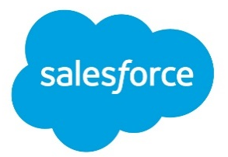


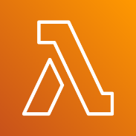
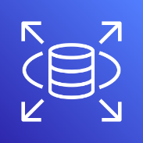
AWS Cloud
VPC
Private subnet
Amazon AppFlow
Amazon S3
AWS Lambda
Amazon RDS

