Slide 1



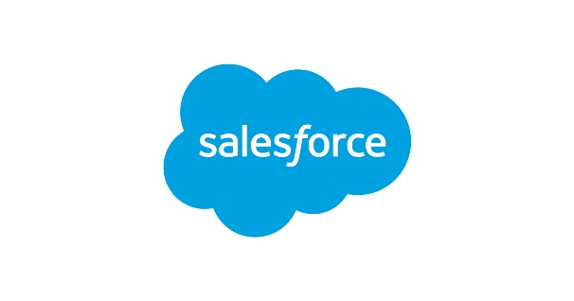



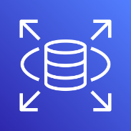
AWS Cloud
VPC
Private subnet
Amazon AppFlow
Amazon Simple Storage Service (Amazon S3)
AWS Lambda
Amazon Relational Database Service (Amazon RDS)

