Slide 1




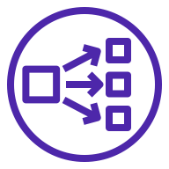



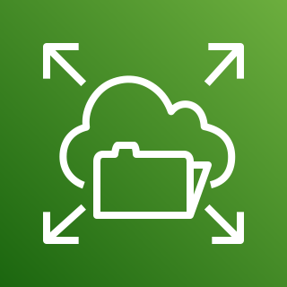


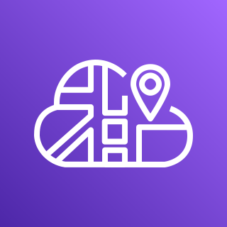
AWS Cloud
Availability Zone 1
Availability Zone 2
VPC
Client
Internet gateway
Public subnet
Network Load Balancer
Public subnet
NAT gateway
NAT gateway
Private subnet
Private subnet
Fargate for Amazon ECS
Amazon EFS
Supported database systems
Redis
Node
Init
Redis
Node
Init
Superset
Celery Beat
Database
Superset
Celery Beat
Database
AWS Cloud Map
Celery Worker
Celery Worker

