Slide 1


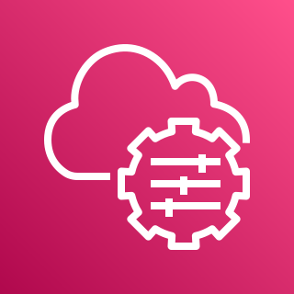
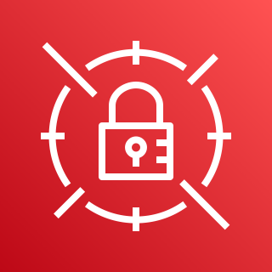





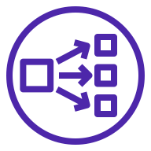




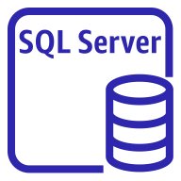
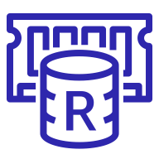
AWS Cloud
Availability Zone
Availability Zone
VPC
Public subnet
Public subnet
Auto Scaling group
AWS Systems Manager
AWS Secrets Manager
RDGW
RDGW
Amazon S3
ACM
Network Load Balancer
Application Load Balancer
Private subnet
Private subnet
Auto Scaling groups
Amazon CloudWatch
Lambda function
Sitecore roles
Sitecore roles
SQL Server
instance
ElastiCache
for Redis

