Slide 1




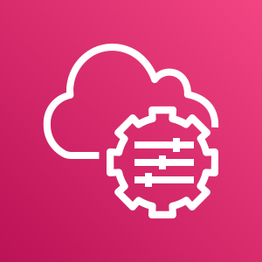










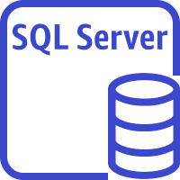



AWS Cloud
Availability Zone 1
Availability Zone 2
VPC
Sitecore external Application Load Balancer
AMI
AWS Systems Manager
Public subnet
Public subnet
Auto Scaling group
NAT gateway
RD Gateway
RD Gateway
NAT gateway
S3 bucket
Amazon CloudWatch
Private subnet
Private subnet
Multiple Auto Scaling groups
Sitecore roles
Sitecore roles
AWS Secrets Manager
AWS Certificate Manager
SQL Server instance
ElastiCache for Redis
SQL Server instance
ElastiCache for Redis
Lambda function
Hosted zone

Slide 2










AWS Cloud
Availability Zone 1
Availability Zone 2
VPC
Public subnet
Public subnet
Auto Scaling group
RD Gateway
RD Gateway
Private subnet
Private subnet
Auto Scaling group
Content delivery
Content delivery
Sitecore AMI
Auto Scaling group
Sitecore external Application Load Balancer
Content management
Content management
Parameter
Store
Auto Scaling group
Identity
Identity
S3 Bucket

