Slide 1



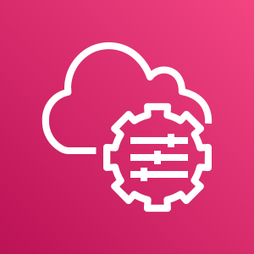














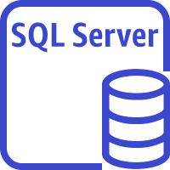
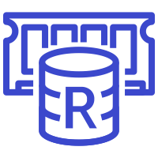
AWS Cloud
Availability Zone 1
Availability Zone 2
VPC
Public subnet
Public subnet
AMI
AWS Systems Manager
Auto Scaling group
NAT gateway
RD Gateway
RD Gateway
NAT gateway
Sitecore internal Application Load Balancer
Sitecore external
Application Load Balancer
Sitecore internal Network Load Balancers
S3 bucket
Amazon CloudWatch
Private subnet
Private subnet
Multiple Auto Scaling groups
AWS Secrets Manager
AWS Certificate Manager
Sitecore roles
Sitecore roles
SQL Server instance
ElastiCache for Redis
SQL Server instance
ElastiCache for Redis
Lambda function
Hosted zone

Slide 2











AWS Cloud
Availability Zone 1
Availability Zone 2
VPC
Public subnet
Public subnet
Auto Scaling group
RD Gateway
RD Gateway
Private subnet
Private subnet
Auto Scaling group
Content delivery
Content delivery
Auto Scaling group
Sitecore external Application Load Balancer
Content management
Content management
Auto Scaling group
Identity
Identity
Auto Scaling group
Collection
Collection
Auto Scaling group
Collection search
Collection search
Auto Scaling group
Reference data
Reference data
Auto Scaling group
Marketing automation
Marketing automation
Private VPC Hosted zone
Auto Scaling group
Cortex processing
Cortex processing
Auto Scaling group
Sitecore AMI
Sitecore internal Network Load Balancers
Cortex reporting
Cortex reporting
Auto Scaling group
Parameter
Store
Processing
Processing
Sitecore internal Application Load Balancer
Auto Scaling group
Reporting
Reporting
S3 Bucket

