Slide 1







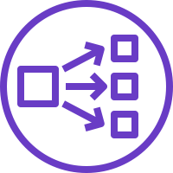


AWS Cloud
Availability Zone 1
Availability Zone 2
VPC
Public subnet
Public subnet
Auto Scaling
group
Amazon EC2
NAT gateway
Barracuda WAF
Barracuda WAF
NAT gateway
Network Load Balancer
Private subnet
Private subnet
Amazon S3

