Slide 1

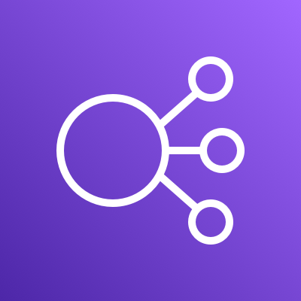








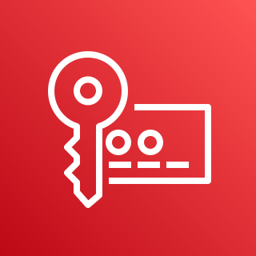

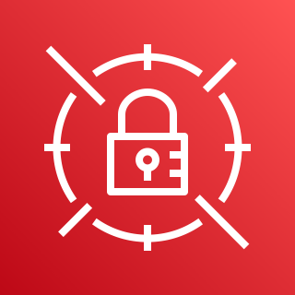
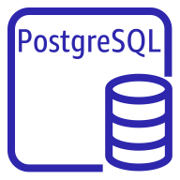

AWS Cloud
Availability Zone 1
Availability Zone 2
VPC
Elastic Load Balancing
Public subnet
Internet gateway
Public subnet
Auto Scaling group
Amazon CloudWatch
NAT gateway
Bastion host
Bastion host
NAT gateway
Private subnet
Private subnet
AWS KMS
Auto Scaling group
Chainlink node
Chainlink node
AWS Secrets Manager
PostgreSQL instance
PostgreSQL instance
Amazon DevOps Guru

