Slide 1














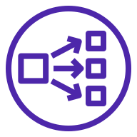


AWS Cloud
Availability Zone 1
Availability Zone 2
VPC
AWS Step Functions
Systems Manager
Internet gateway
Internet gateway
Public subnet
Public subnet
Amazon EventBridge
Route 53
NAT gateway
NAT gateway
Private subnet
Private subnet
Amazon Simple Notification Service (Amazon SNS)
CloudWatch
ISE-1
Network Load Balancer
ISE-2
AWS Lambda
Amazon S3

