Slide 1
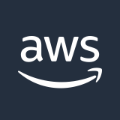

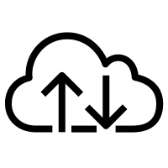

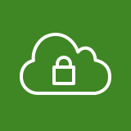


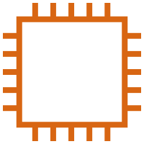
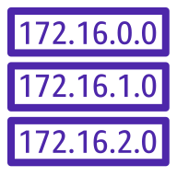
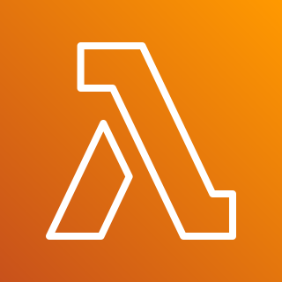


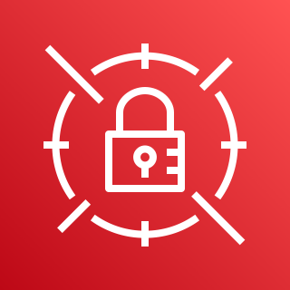
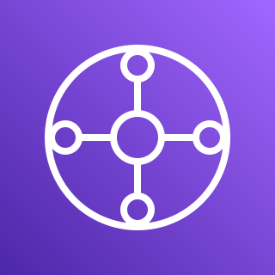
AWS Cloud
Meraki branches
Meraki Auto VPN
Internet gateway
Meraki dashboard
Availability Zone 1
Availability Zone 2
VPC
Public subnet
Public subnet
Amazon CloudWatch
Meraki vMX
Public route table
Meraki vMX
Private subnet
Private subnet
AWS Lambda
Elastic network interface
Elastic network interface
AWS Secrets Manager
AWS Transit Gateway
Transit gateway route table
Workload VPCs

Slide 2
AWS Cloud
Branch offices
Meraki Auto VPN
Internet gateway
Meraki dashboard
Availability Zone 1
Availability Zone 2
VPC
Public subnet
Public subnet
Amazon CloudWatch
Meraki vMX
VPC public route table
Meraki vMX
Private subnet
Private subnet
AWS Lambda
Elastic network interface
Elastic network interface
AWS Secrets Manager
AWS Transit Gateway
Transit gateway route table
Workload VPCs

