Slide 1

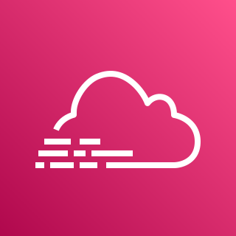





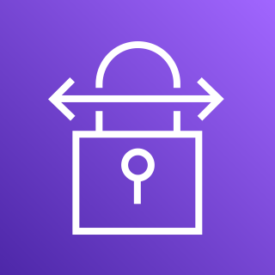




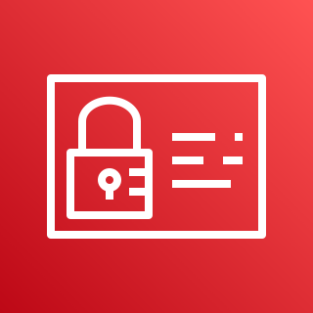
AWS Cloud
Development VPC
AWS CloudTrail
Amazon Simple Storage Service (S3)
Management VPC
Flow logs
***All Flow Logs go to CloudWatch
Amazon CloudWatch
Amazon Simple Storage Service (S3)
NAT gateway
Customer Connectivity
AWS Config
Amazon Simple Storage Service (S3)
AWS Site-to-Site VPN
Internet gateway
Flow logs
AWS Transit Gateway
AWS Direct Connect
Amazon Simple
Notification Service
Production VPC
NAT gateway
AWS Identity & Access Management
Flow logs

Slide 2



AWS Cloud
Management VPC
Production VPC
Development VPC
Access Control and Alerting
Availability Zone
Availability Zone
Availability Zone
Availability Zone
Availability Zone
Availability Zone
Private subnet
Private subnet
Private subnet
Private subnet
Private subnet
Private subnet
Amazon Simple Notification Service
Public subnet
Public subnet
AWS Identity & Access Management
NAT gateway
NAT gateway
Customer Connectivity
Internet gateway
Flow logs
Flow logs
Flow logs
AWS Site-to-Site VPN
AWS Transit Gateway
Logging and audit controls
AWS Direct Connect
***All Flow Logs go to CloudWatch
Flow logs
Amazon CloudWatch
AWS Config
AWS CloudTrail
Amazon Simple Storage Service (S3)
Amazon Simple Storage Service (S3)
Amazon Simple Storage Service (S3)

