Slide 1










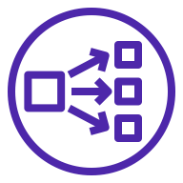




AWS Cloud
Cribl Stream users
Availability Zone 1
Application Load Balancer
Availability Zone 2
Cribl-supported destinations
VPC
Public subnet
Public subnet
Auto Scaling group
S3 bucket
Cribl Stream leader node
Auto Scaling group
Data lake
AWS PrivateLink
VPC endpoint
Network Load Balancer
Cribl Stream worker node
Cribl Stream worker node
Amazon OpenSearch Service
AWS account
Cribl Stream worker nodes
S3 bucket
Amazon Kinesis

Slide 2



AWS Cloud
Cribl Stream users
Availability Zone 1
Application Load Balancer
Availability Zone 2
VPC
Public subnet
Public subnet
Auto Scaling group
IAM
Cribl Stream leader node
Auto Scaling group
PrivateLink
VPC endpoint
Network Load Balancer
Cribl Stream worker node
Cribl Stream worker node
Supported data destinations
AWS account
Supported data sources

