Slide 1











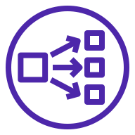


Cribl Stream Distributed Deployment (PrivateLink)
AWS Cloud
VPC
Public subnet
Availability Zone 1
Availability Zone 2
Destinations
Stream
Users
Application Load Balancer
Auto Scaling Group
Amazon S3
Bucket
Stream Leader
AWS PrivateLink
Private subnet
Data lake
Network Load Balancer
Auto Scaling Group
Stream Worker(s)
Stream Worker(s)
Analytics Solution
Account A
Account C
Amazon S3
Bucket
Amazon Kinesis
Amazon S3
Bucket
Cribl Stream Worker(s)
Cribl Stream Worker(s)
Amazon Kinesis

