Slide 1













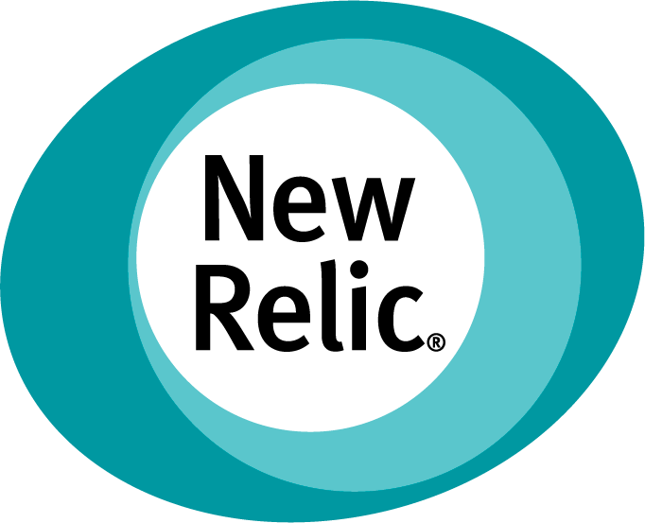




AWS Cloud
AWS Control Tower management account
AWS Control Tower home Region
Life cycle event
Dead letter queue
Administrator
New account
EventBridge rule
New Relic StackSet function
Register SNS topic
New Relic register function
NerdGraph API key secret
Stack SNS
Onboarding function
New Relic stack set
New AWS account
Metrics Streaming
Metrics
New Relic stack
Cross Account IAM Role
Cloudwatch Metrics Stream
Firehose Metrics Delivery Stream
EC2 Infrastructure Monitoring Agent Installation
Metrics
ec2 instances
Installation Logs
State Manager
Association
SSM Automation
Document
Event Bridge Rule
Dead letter queue

