Slide 1




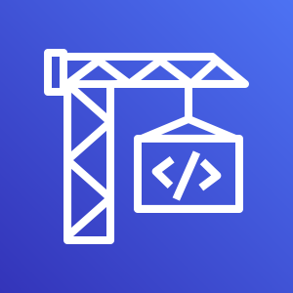



AWS Cloud
Amazon S3
CI/CD pipeline
Git push
Git webhook
Developers
GitHub repository
AWS CodePipeline
Source stage: Integrates the application source code.
AWS CodeBuild
Build stage: Creates the build package.
AWS CodeDeploy
Deploy stage: Deploys the build package.
AWS Elastic Beanstalk

