Slide 1
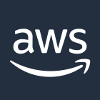
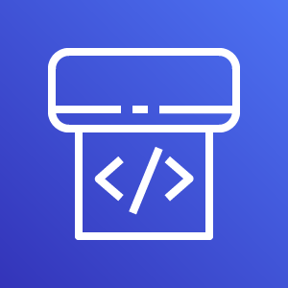


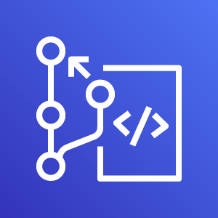

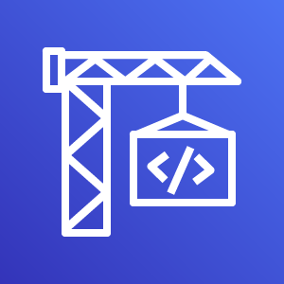



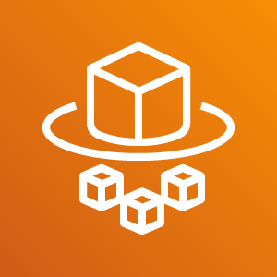



AWS Cloud
Availability Zone 1
Availability Zone 2
CodePipeline
VPC
CodeCommit
Public subnet
Public subnet
CodeBuild
NAT gateway
NAT gateway
ECS Deployment
Private subnet
Private subnet
ECS Service
Fargate Task
Application Load Balancer (ALB)
Fargate Task
S3 Build
Artifacts

