Slide 1


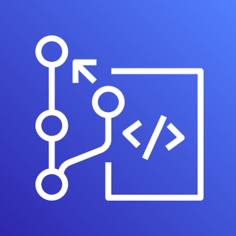




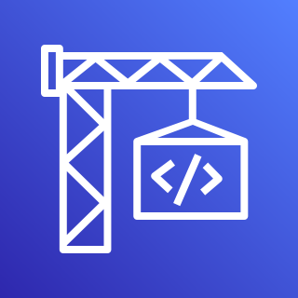





AWS Cloud
AWS CodePipeline
Availability Zone 1
Availability Zone 2
VPC
Public subnet
Public subnet
AWS CodeCommit
Amazon S3
NAT gateway
NAT gateway
AWS CodeBuild
Private subnet
Private subnet
IAM
AWS Fargate task
Application Load Balancer
AWS Fargate task
Amazon ECS

