Slide 1






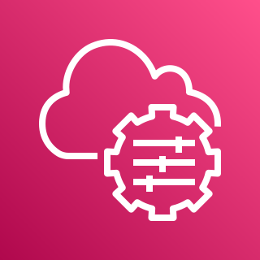




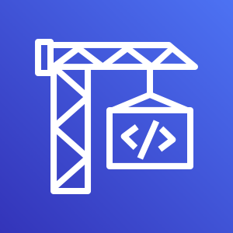
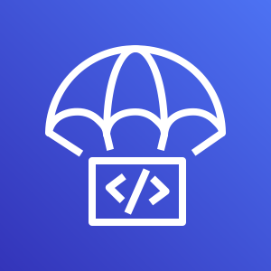

AWS Cloud
Build
Default VPC
Container Image
Amazon S3
Temporary EC2 Instance
Amazon ECR
Systems Manager
Source
Build
Deploy
CodeBuild initiates EC2 instance provisioning.
EC2 instance is used to create Docker image
Update Amazon ECS Task Definition Container Image
Developers
GitHub Repository
Amazon ECS
AWS CodeBuild
AWS CodeDeploy
AWS CodePipeline

