Slide 1







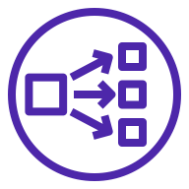






AWS Cloud
Availability Zone 1
Availability Zone 2
VPC
Public subnet
Internet gateway
Public subnet
Amazon Route 53
NAT gateway
Network Load Balancer
NAT gateway
Amazon EFS
Private subnet
Private subnet
ACM
Auto Scaling group
AWS Fargate
AWS Fargate
Amazon S3
Amazon ECR

