Slide 1

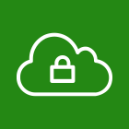


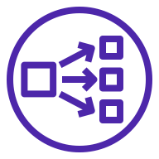
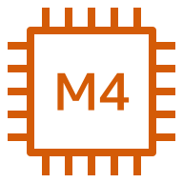
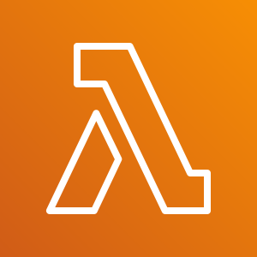
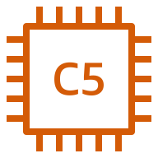


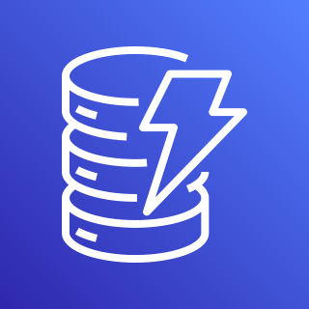


AWS Cloud
Availability Zone 1
Availability Zone 2
VPC
Internet gateway
Public subnet
Public subnet
FortiAnalyzer
Network Load Balancer (public)
FortiGate cluster
AWS Lambda
BYOL Auto Scaling group
FortiGate
FortiGate
On-demand Auto Scaling group
Amazon S3
FortiGate
FortiGate
Private subnet
Private subnet
Amazon DynamoDB
Protected instances
Network Load Balancer
(private)
Protected instances

