Slide 1
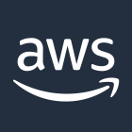
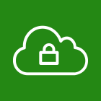

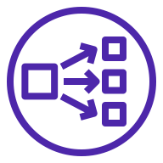
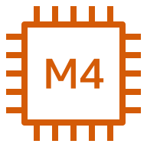
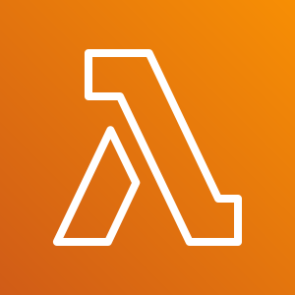
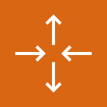
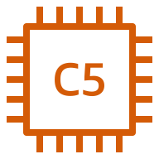

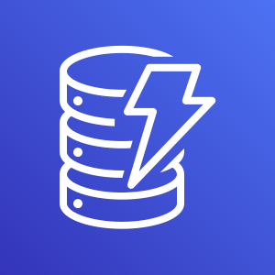

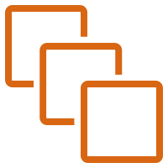
AWS Cloud
Availability Zone 1
Availability Zone 2
VPC
Public subnet
Public subnet
FortiAnalyzer
Network Load Balancer
(public)
AWS Lambda
Auto Scaling group
FortiGate
(main, BYOL)
FortiGate
Amazon S3
Auto Scaling group
FortiGate (host, on-demand)
FortiGate
Amazon DynamoDB
Private subnet
Private subnet
Your protected instances
Network Load Balancer
(private)
Your protected instances

