Slide 1
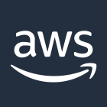


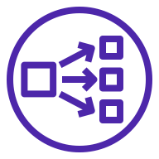
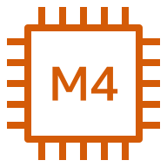
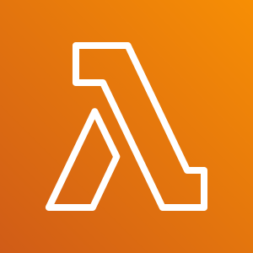
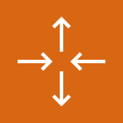
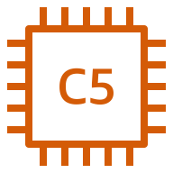

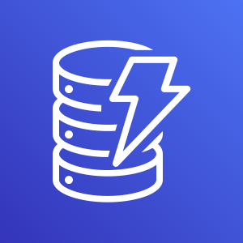

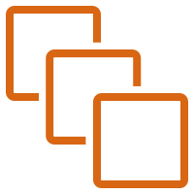
AWS Cloud
Availability Zone 1
Availability Zone 2
VPC
Public subnet
Public subnet
FortiAnalyzer
Network Load Balancer
(public)
AWS Lambda
Auto Scaling group
FortiGate
(main)
FortiGate
Amazon S3
Auto Scaling group
FortiGate (host)
FortiGate
Amazon DynamoDB
Private subnet
Private subnet
Your protected instances
Network Load Balancer
(private)
Your protected instances

