Slide 1










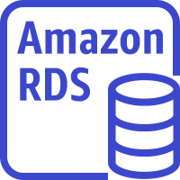
AWS Cloud
Availability Zone 1
Availability Zone 2
VPC
Public subnet
Public subnet
Auto Scaling group
NAT gateway
Bastion host
Bastion host
NAT gateway
Private subnet
Elastic Load Balancing
Private subnet
Auto Scaling group
IBM Maximo
IBM Maximo
Amazon EC2
Auto Scaling group
Deployment
manager
Amazon Route 53
Synchronous
Replication
Amazon RDS (master)
Amazon RDS
(standby)

Slide 2
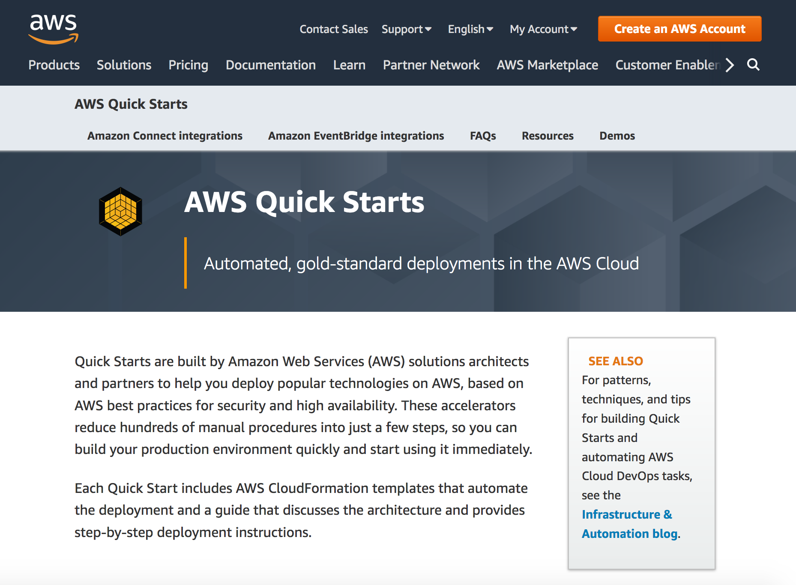

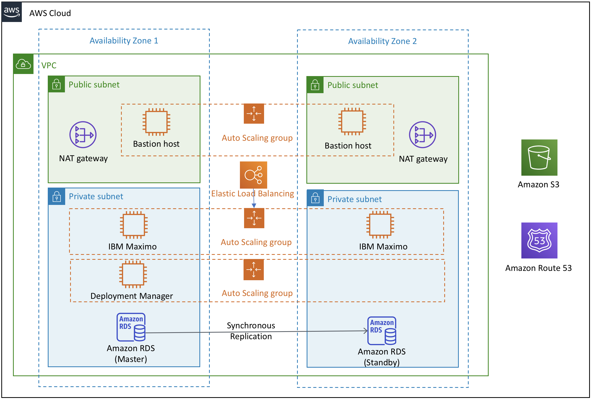

AWS QuickStart for IBM Maximo for Utilities reduces hundreds of manual procedures into just a few steps, so you can build your Maximo environment quickly and start using it immediately.
Admin
AWS Quick Start for Maximo Utilities – Deployment Flow
AWS QuickStart provisions a gold-standard deployment of Maximo for Utilities in the AWS Cloud.
Now, you are ready to configure and customize Maximo deployment and start using it for your enterprise needs, whether it is Dev, test or production.
Users

