Slide 1




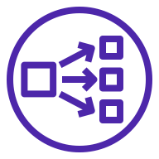




AWS Cloud
Availability Zone 1
Availability Zone 2
Availability Zone 3
VPC
Public subnet
Public subnet
Public subnet
NAT gateway
NAT gateway
NAT gateway
Network Load Balancer
Network Load Balancer
Network Load Balancer
Private subnet
Private subnet
Private subnet
Amazon EKS
IBM MQ
IBM MQ
IBM MQ
Native HA data replication and availability
EBS volume
EBS volume
EBS volume

