Slide 1
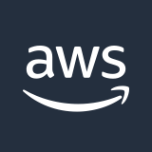
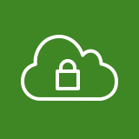
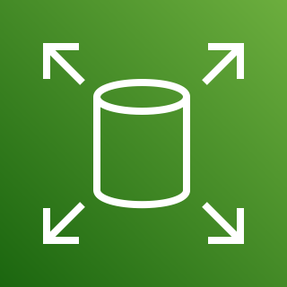

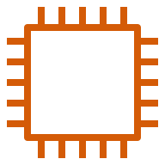
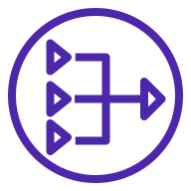
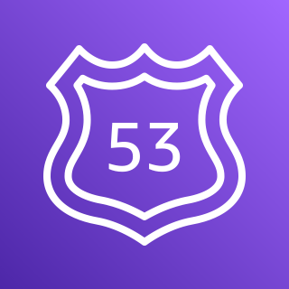

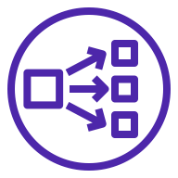


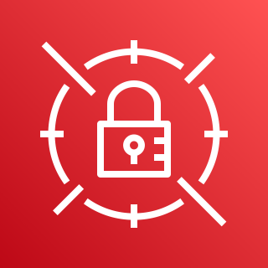
AWS Cloud
Availability Zone
VPC
Public subnet
Amazon EBS
Boot node / bastion host
NAT gateway
Private subnet
Amazon Route 53
Network Load Balancer
Control plane node
Control plane node
Control plane node
OpenShift autoscaling
Amazon S3
Classic Load Balancer
Compute node with storage
Compute node with storage
Compute node with storage
AWS Secrets Manager
This Quick Start sets up the following:
A single-AZ reference architecture.
A virtual private cloud configured with public and private subnets, according to AWS best practices, to provide you with your own virtual network on AWS.*
In the public subnet:
A managed network address translation (NAT) gateway to allow outbound internet access for resources in the private subnet.*
An Amazon Elastic Compute Cloud (Amazon EC2) instance for a boot node and bastion host to allow outbound internet access for resources in the private subnet.
In the private subnet, a Red Hat OpenShift Container Platform (OCP) cluster deployed to Amazon EC2 instances. The cluster contains the following nodes:
Control plane nodes for cluster management and the OpenShift web console.
Compute nodes in an OpenShift autoscaling group. Guardium Insights runs as a containerized application on the compute nodes.
A Network Load Balancer for routing internal and external OpenShift API traffic to control plane nodes.
A Classic Load Balancer for routing web browser traffic to Guardium Insights on the compute nodes.
Amazon Elastic Block Storage (Amazon EBS) for volumes attached to compute nodes to persist container data.
Amazon Route 53 for the public Domain Name System (DNS) for resolving domain names of the Guardium Insights console and deployed applications.
Amazon Simple Storage Service (Amazon S3) to store the OpenShift pull secret, TLS certificate and key, and OpenShift image registry.
AWS Secrets Manager to encrypt, store, and retrieve credentials and secrets for the Guardium Insights deployment.
This Quick Start deploys IBM Security Guardium Insights on the AWS Cloud. It is for organizations that want security monitoring of data sources and user activity, anomaly remediation, and a central console for threat visualization and reporting. Guardium Insights runs on the Red Hat OpenShift Container Platform (OCP), a Kubernetes system for container-based workloads. After deployment, use the customizable Guardium Insights console for daily data security and compliance tasks, and the OpenShift console to manage the cluster.

