Slide 1


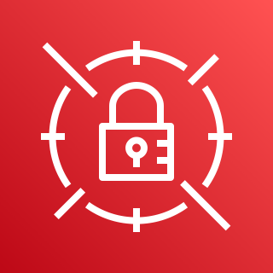


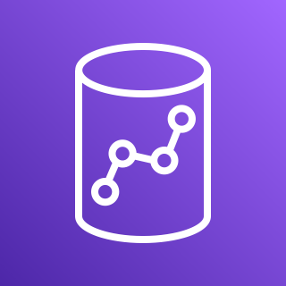






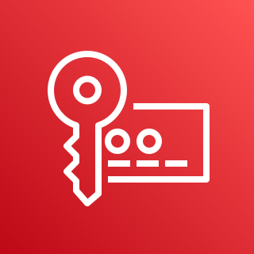
AWS Cloud
VPC
Availability Zone
Availability Zone
AWS PrivateLink
Public subnet
Public subnet
AWS Secrets Manager
NAT gateway
Amazon Redshift
AWS Identity and Access Management (IAM)
Amazon AppFlow
Private subnet
Private subnet
Amazon Simple Storage Service (Amazon S3)
AWS Lambda
AWS Key Management Service (AWS KMS)

Slide 2
AWS Cloud
VPC
Availability Zone
Availability Zone
AWS PrivateLink
Public subnet
Public subnet
AWS Secrets Manager
NAT gateway
Amazon AppFlow
Amazon Redshift
AWS Identity and Access Management (IAM)
Private subnet
Private subnet
Amazon Simple Storage Service (Amazon S3)
AWS Lambda
AWS Key Management Service (AWS KMS)

Slide 3
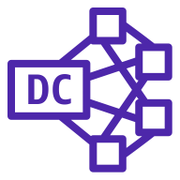
AWS Cloud
VPC
Availability Zone
Availability Zone
AWS PrivateLink
Public subnet
Public subnet
AWS Secrets Manager
NAT gateway
Amazon Redshift
AWS Identity and Access Management (IAM)
Amazon AppFlow
Private subnet
Private subnet
Redshift Nodes
Amazon Simple Storage Service (Amazon S3)
AWS Lambda
Dense compute node
Dense compute node
AWS Key Management Service (AWS KMS)

Slide 4
AWS Cloud
VPC
Availability Zone
Availability Zone
AWS PrivateLink
Public subnet
Public subnet
AWS Secrets Manager
NAT gateway
Amazon AppFlow
Amazon Redshift
AWS Identity and Access Management (IAM)
Private subnet
Private subnet
Redshift Nodes
Amazon Simple Storage Service (Amazon S3)
AWS Lambda
Dense compute node
Dense compute node
AWS Key Management Service (AWS KMS)

