Slide 1






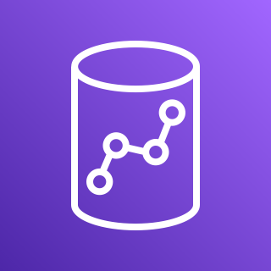

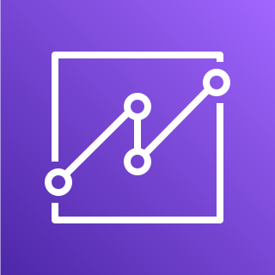
AWS Cloud
Amazon CloudWatch
AWS Step Functions workflow
Amazon S3
Amazon AppFlow
Amazon Redshift
Users
Amazon QuickSight

