Slide 1











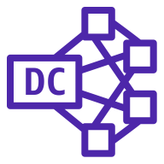


AWS Cloud
Availability Zone 1
Availability Zone 2
VPC
AWS PrivateLink
Amazon QuickSight
Public subnet
Public subnet
NAT gateway
NAT gateway
Amazon AppFlow
IAM
Private subnet
Private subnet
Amazon Redshift
cluster
AWS Lambda
AWS Secrets Manager
Dense Compute node
Dense Compute node
Amazon S3
AWS KMS

Slide 2






AWS Cloud
VPC
Private subnet
Lambda
Amazon Redshift
dense compute node
S3 bucket
AWS PrivateLink
Amazon AppFlow
Marcia to Troy: Would a diagram like this help people do the deployment, or should we reconsider whether it belongs in the deployment guide?
Troy: Let’s just leave it out. See next slide…

Slide 3



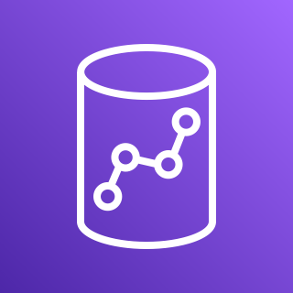

AWS Cloud
Amazon CloudWatch
Marcia to Troy: If a flow diagram is relevant to deploying, this should be part of it, yes? (Some of these arrow directions confuse me.) Troy: Let’s just leave it out. See next slide…
AWS Step Functions workflow
Amazon S3
Amazon AppFlow
Amazon Redshift
Users
Amazon QuickSight

Slide 4
AWS Cloud
VPC
Private subnet
Marcia to Troy: If we want to include a flow diagram, please give a shot at pulling together the two previous flows. Troy: Let’s just leave it out.
Users

Slide 5
AWS Cloud
VPC
Availability Zone
Availability Zone
AWS PrivateLink
Public subnet
Public subnet
AWS Secrets Manager
NAT gateway
Amazon Redshift
AWS Identity and Access Management (IAM)
Amazon AppFlow
Private subnet
Private subnet
Amazon Simple Storage Service (Amazon S3)
AWS Lambda
AWS Key Management Service (AWS KMS)

Slide 6
AWS Cloud
VPC
Availability Zone
Availability Zone
AWS PrivateLink
Public subnet
Public subnet
AWS Secrets Manager
NAT gateway
Amazon AppFlow
Amazon Redshift
AWS Identity and Access Management (IAM)
Private subnet
Private subnet
Amazon Simple Storage Service (Amazon S3)
AWS Lambda
AWS Key Management Service (AWS KMS)

Slide 7
AWS Cloud
VPC
Availability Zone
Availability Zone
AWS PrivateLink
Public subnet
Public subnet
AWS Secrets Manager
NAT gateway
Amazon Redshift
AWS Identity and Access Management (IAM)
Amazon AppFlow
Private subnet
Private subnet
Redshift Nodes
Amazon Simple Storage Service (Amazon S3)
AWS Lambda
Dense compute node
Dense compute node
AWS Key Management Service (AWS KMS)

Slide 8
AWS Cloud
VPC
Availability Zone
Availability Zone
AWS PrivateLink
Public subnet
Public subnet
AWS Secrets Manager
NAT gateway
Amazon AppFlow
Amazon Redshift
AWS Identity and Access Management (IAM)
Private subnet
Private subnet
Redshift Nodes
Amazon Simple Storage Service (Amazon S3)
AWS Lambda
Dense compute node
Dense compute node
AWS Key Management Service (AWS KMS)

