Slide 1











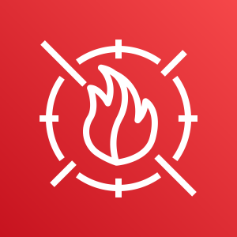
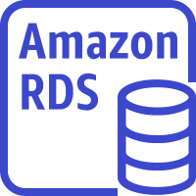


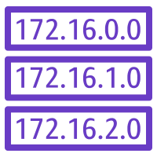




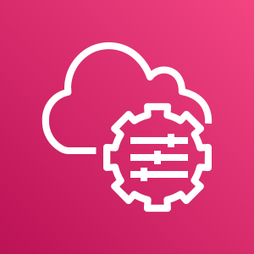
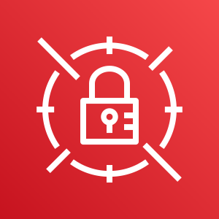
AWS Cloud
Management VPC
Production VPC
Availability Zone 1
Availability Zone 2
Availability Zone 1
Availability Zone 2
AWS IAM
Public subnet
Public subnet
Public subnet
Public subnet
Auto Scaling
group
Security group
Security group
Security group
AWS KMS
NAT
gateway
NAT
gateway
EC2 instance (web)
EC2 instance (web)
Bastion host
NAT
gateway
Private subnet
Private subnet
Private subnet
Amazon SNS
Private subnet
Auto Scaling
group
Security group
Security group
EC2 instance (app)
EC2 instance (app)
AWS Config
Private subnet
Private subnet
AWS WAF
Replication
Amazon RDS instance
Amazon RDS instance
Amazon S3
Peering
connection
Route table
Internet gateway
Application
Load Balancer
Amazon GuardDuty
Amazon CloudWatch
AWS Systems Manager
AWS Secrets Manager

