Slide 1






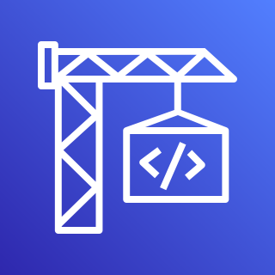




AWS Cloud
Amazon CloudWatch
AWS CodePipeline
AWS CodeCommit
Liquibase Pro via AWS CodeBuild
Users
AWS Secrets Manager
AWS CodeBuild
Liquibase Pro
Amazon Simple Storage Service (Amazon S3)
VPC
Test
Staging
Production
Amazon Relational Database Service (Amazon RDS)
Approval
Amazon RDS
Approval
Amazon RDS)

