Slide 1





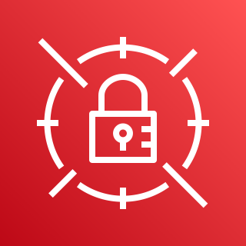

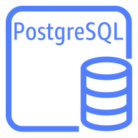


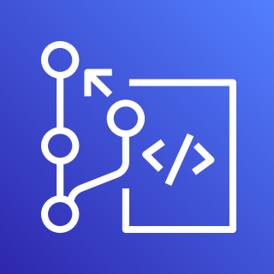
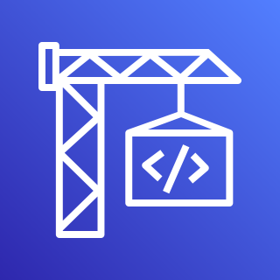


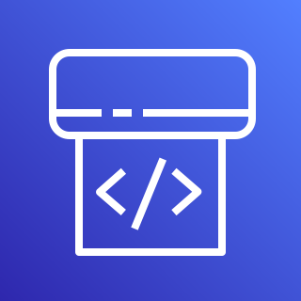
AWS Cloud
Availability Zone
VPC
Public subnet
NAT gateway
Private subnet
Test
Amazon RDS instance
AWS Secrets
Manager
Amazon S3
User
CodeBuild build
Approval
Staging
AWS CodeCommit
Liquibase Pro
Amazon RDS instance
AWS CodeBuild
Approval
Production
Amazon
CloudWatch
AWS CodePipeline
Amazon RDS instance

