Slide 1







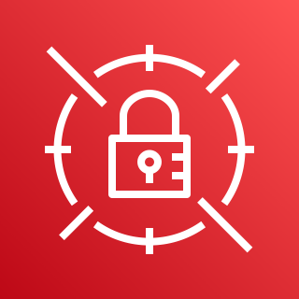

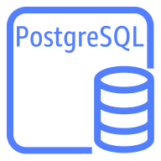

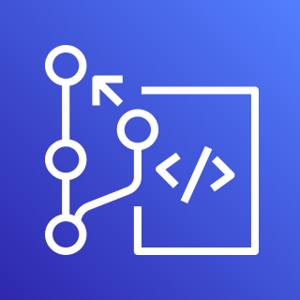


AWS Cloud
Availability Zone
VPC
Public subnet
Amazon S3
NAT gateway
Private subnet
AWS CodeBuild
Testing
AWS Secrets
Manager
Amazon RDS instance
Liquibase Pro
User
Approval
Staging
AWS CodeCommit
Amazon RDS instance
Approval
Testing
Amazon CloudWatch
AWS CodePipeline
Amazon RDS instance

