Slide 1

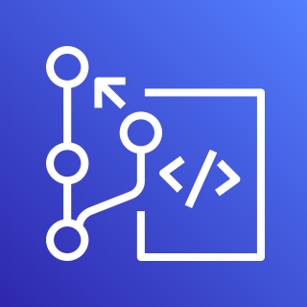


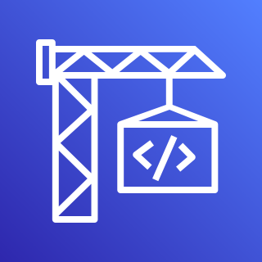








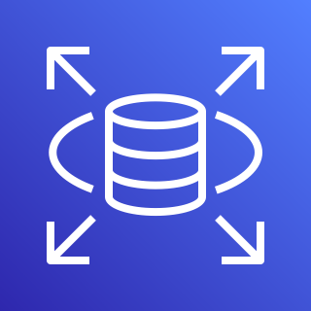
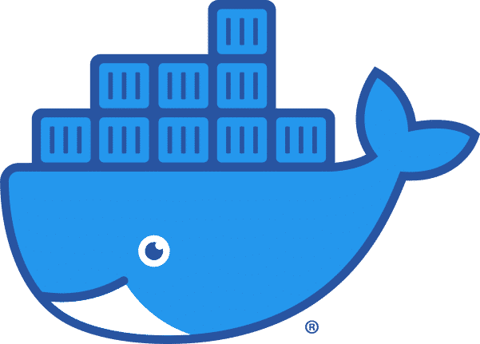
AWS Cloud
AWS CodeCommit
Amazon CloudWatch
AWS CodePipeline
AWS CodeBuild
Amazon S3
Users
AWS Secrets Manager
VPC
Liquibase
Public subnet
Private subnet
Test
Staging
Production
NAT Gateway
Amazon RDS
Approval
Amazon RDS
Approval
Amazon RDS
Docker Hub

