Slide 1


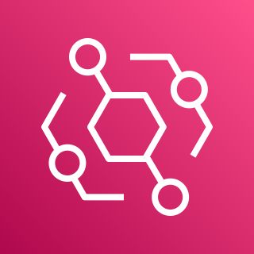

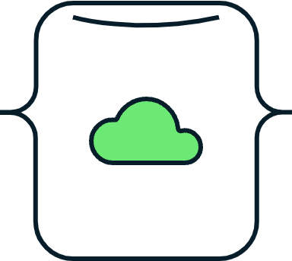
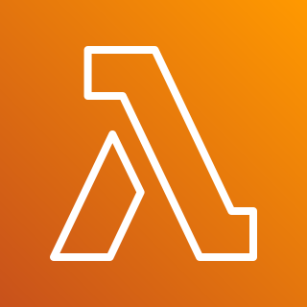


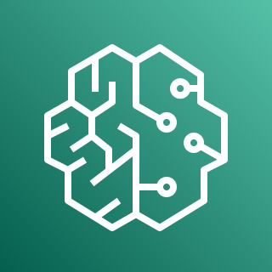



AWS Cloud
Region
SageMaker
Result Event
SageMaker
Result Event
EventBridge
Push Lambda
Event Rule
Custom
Event Bus
MongoDB Database
SageMaker
Pull Lambda
Pre-trained
Model
Realm Trigger
SaaS Event Bus
(Partner Event Bus)
Event Rule
MongoDB
Change Event
MongoDB
Change Event

