Slide 1


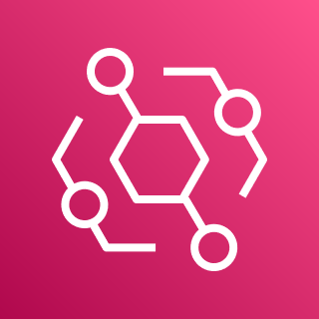





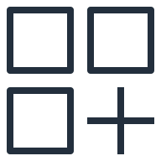

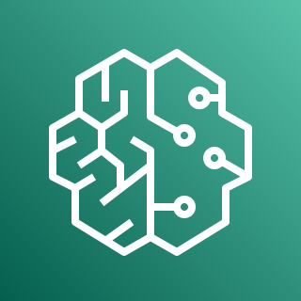
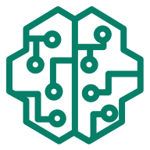
AWS Cloud
MongoDB SaaS account
Customer account
Amazon EventBridge
SageMaker results
MongoDB cluster
Push results
Route results to push function
Custom
event bus
Artifacts
MongoDB changes
Realm trigger
Partner SaaS
event bus
Route events to pull function
Pull events
Amazon SageMaker
Pretrained ML model
In the MongoDB SaaS account:
A MongoDB cluster.
A MongoDB Atlas Realm trigger to send database change events to Amazon EventBridge in the customer account.
In the customer account:
Amazon EventBridge to ingest MongoDB change events from the Realm trigger and send Amazon SageMaker result events back to the MongoDB database. EventBridge uses the following event buses and rules:
A Partner SaaS event bus to receive MongoDB change events from the Realm trigger.
A rule to route events to the pull events Lambda function.
A custom event bus to receive SageMaker result events from the pull events Lambda function.
A rule to route results to the push results Lambda function.
Two Lambda functions:
A pull events function to read events from the Partner SaaS event bus and get results from SageMaker.
A push results function to write results from SageMaker to the MongoDB database in the MongoDB SaaS account.
An Amazon Simple Storage Service (Amazon S3) bucket for model-training artifacts.
Amazon SageMaker to provide an endpoint to a pretrained ML model.

