Slide 1










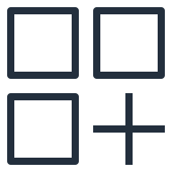

AWS Cloud
MongoDB SaaS account
Customer account
Amazon EventBridge
SageMaker result event
SageMaker result event
MongoDB database
Push Lambda function
Rule
Custom
event bus
Amazon SageMaker
Pull Lambda function
Pre-trained Model
Realm trigger
Partner SaaS
event bus
Rule
MongoDB change event
MongoDB change event

Slide 2

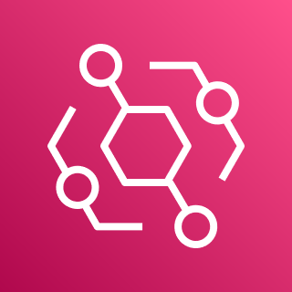
AWS Cloud
MongoDB SaaS account
Customer account
Amazon EventBridge
SageMaker result event
MongoDB database
Push results
Push rule
Custom
event bus
MongoDB change event
Realm trigger
Partner SaaS
event bus
Pull rule
Pull events
Amazon SageMaker
Model

