Slide 1










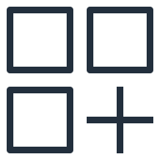

AWS Cloud
MongoDB SaaS account
Customer account
Amazon EventBridge
SageMaker result event
SageMaker result event
MongoDB database
Push Lambda function
Rule
Custom
event bus
Amazon SageMaker
Pull Lambda function
Pre-trained Model
Realm trigger
Partner SaaS
event bus
Rule
MongoDB change event
MongoDB change event

