Slide 1

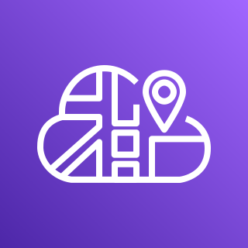









AWS Cloud
Availability Zone 1
Availability Zone 2
MongoDB Atlas project VPC
VPC
Public subnet
Public subnet
Availability Zone 1
Availability Zone 2
Availability Zone 3
AWS Cloud Map
NAT gateway
NAT gateway
AWS PrivateLink
Application Load Balancer
Amazon Elastic Container Registry (Amazon ECR)
MongoDB Atlas cluster
Client service
Client service
Server service
Server service
AWS Fargate

