Slide 1


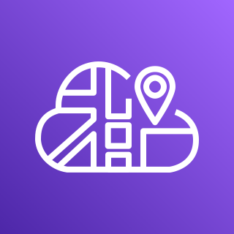







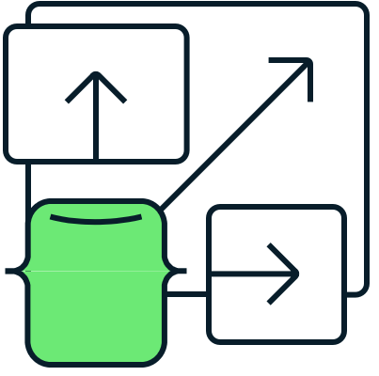



AWS Cloud
Region
AWS CloudMap
AWS Identity and Access
Management (IAM)
Amazon ECR
VPC
Atlas VPC
Amazon ECS
Public subnet
Private subnet
AWS Fargate
Application
Load Balancer
AWS PrivateLink
Service
MongoDB Atlas Cluster

