Slide 1


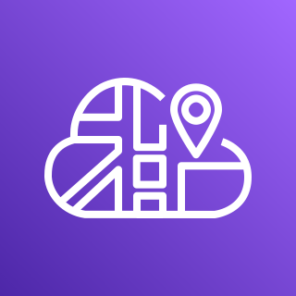


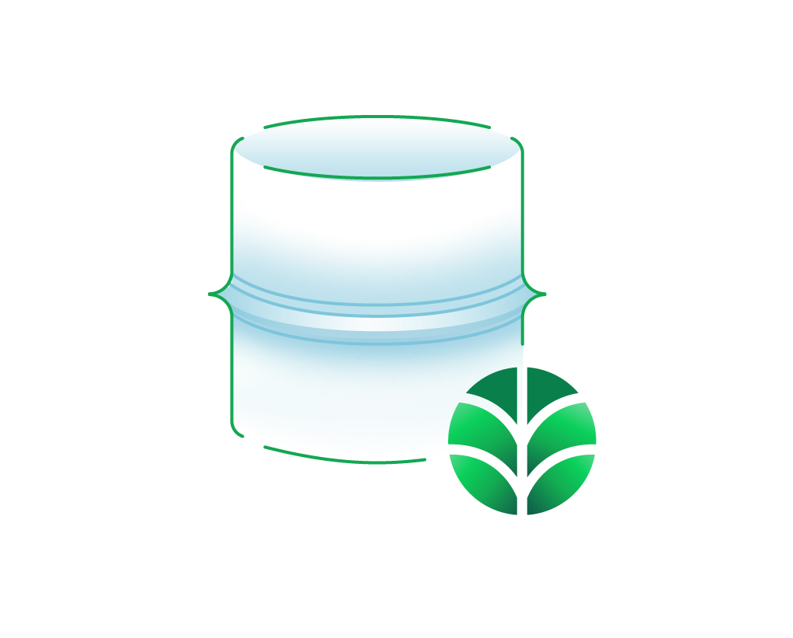






AWS Cloud
Availability Zone 1
Availability Zone 2
MongoDB Atlas project VPC
VPC
Availability Zone 1
Availability Zone 2
Availability Zone 3
Public subnet
Public subnet
AWS Cloud Map
AWS PrivateLink
NAT gateway
NAT gateway
MongoDB Atlas cluster
Amazon ECR
Image URI
Client service
Application Load Balancer
Client service
Image URI
Server service
Server service
AWS Fargate

