Slide 1


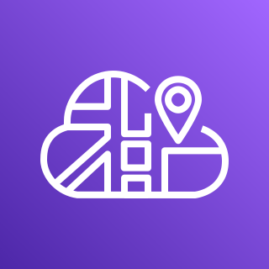



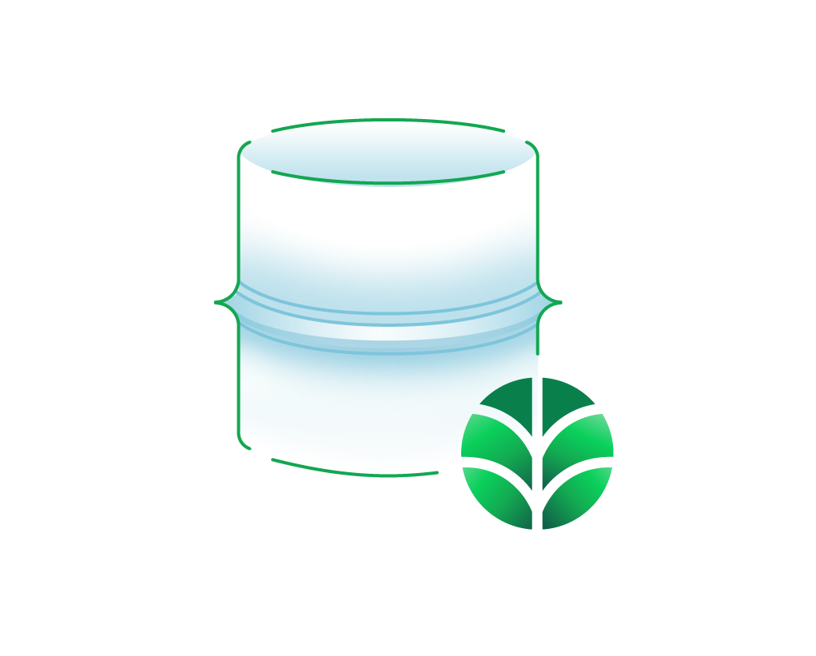





AWS Cloud
Availability Zone 1
Availability Zone 2
MongoDB Atlas project VPC
VPC
Availability Zone 1
Availability Zone 2
Availability Zone 3
Public subnet
Public subnet
AWS Cloud Map
AWS PrivateLink
NAT gateway
NAT gateway
MongoDB Atlas cluster
Image URI
Angular client application
Application Load Balancer
Angular client application
Amazon ECR
Image URI
Server application
Server application
AWS Fargate

