Slide 1




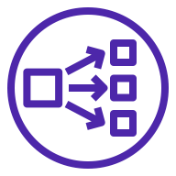

AWS Cloud
Availability Zone 1
Availability Zone 2
Availability Zone 3
VPC
Public subnet
Public subnet
Public subnet
Security group
Internet
gateway
Network Load Balancer
Instance
Instance
Instance

Slide 2


AWS Cloud
Availability Zone 1
Availability Zone 2
Availability Zone 3
VPC
Public subnet
Public subnet
Public subnet
Security group
Auto Scaling group
User
Internet
gateway
Network Load Balancer
Neo4j
Neo4j
Neo4j

Slide 3
AWS Cloud
Availability Zone 1
Availability Zone 2
Availability Zone 3
VPC
Public subnet
Public subnet
Public subnet
Auto Scaling group
Security group
User
Internet
gateway
Network Load Balancer
Neo4j
Neo4j
Neo4j

