Slide 1




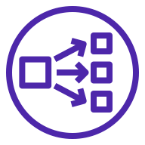


AWS Cloud
VPC
Availability Zone
Availability Zone
Availability Zone
Public subnet
Public subnet
Public subnet
Auto Scaling group
Security group
Neo4j Instance
Neo4j Instance
Neo4j Instance

