Slide 1


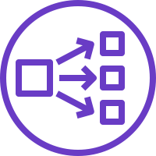

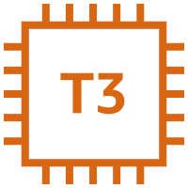

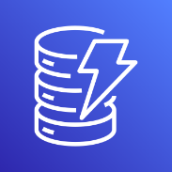






AWS Cloud
VPC
Arkime ELB
Suricata ELB
Zeek ELB
Wireshark ELB
Availability Zone 1
Availability Zone 2
Public subnet
Public subnet
Bastion host
NAT gateway
NAT gateway
Private subnet
Private subnet
Amazon DynamoDB
Auto Scaling group
Arkime instance
Arkime instance
Auto Scaling group
Amazon ES
Suricata instance
Suricata instance
Traffic Mirroring
Auto Scaling group
Traffic Mirroring
Wireshark instance
Wireshark instance
Auto Scaling group
Amazon S3
Zeek instance
Zeek instance

