Slide 1









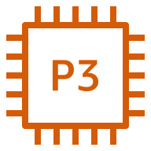





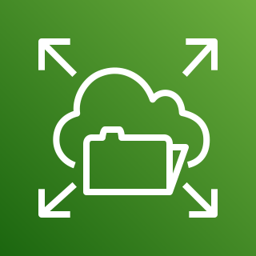
AWS Cloud
Availability Zone
Availability Zone
VPC
Internet gateway
Public subnet
Public subnet
Amazon ECS
NAT gateway
Application Load Balancer
NAT gateway
Private subnet
Private subnet
Namespace
P3 instance
Auto Scaling group
P3 instance
Task
Container
Amazon CloudWatch
Container
Task
Cheminformatics service
Container
Task
MegaMolBART service
Task
Container
Amazon EFS

