Slide 1







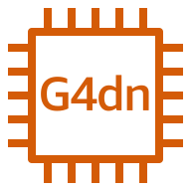
AWS Cloud
VPC
Availability Zone
Availability Zone
Availability Zone
Public subnet
Public subnet
Public subnet
NAT gateway
NAT gateway
NAT gateway
EC2 Primary Node
Primary
Collaboration and Clustering Auto Scaling group
G4dn instance
G4dn instance
G4dn instance
Collaborators

