Slide 1







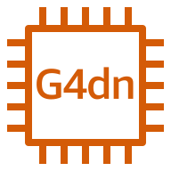
AWS Cloud
Availability Zone
Availability Zone
Availability Zone
VPC
Public subnet
Public subnet
Public subnet
NAT gateway
NAT gateway
NAT gateway
EC2 primary node
Primary
Auto Scaling group
(collaboration and clustering)
G4dn instance
G4dn instance
G4dn instance
Collaborators

